Slide 1
National Board of Directors FLC Report
Linking with our Members
Notes:
Speakers notes:
Welcome to FLC
Appreciate the opportunity to connect with our members
Who is on the Board Committees?
What are the Committees working on over the next few months?
How does what we do impact you and your Clubs?

Slide 2

Committees of the National Board
Notes:
Speakers notes:
Your National Board is made up of National Directors as well as the PNP, NP, and NVP
The bulk of the work of the Board is done by Board Committees, each with it’s own terms of reference and priorities to advance the Association by meeting the objectives of the Strategic Plan. Each committee impacts the others and in turn, allows the Board to complete its responsibilities.
Human Resources – Chaired by PNP James, with members NP Terri, and NVP Erin
Review of Executive Director
Facilitate qualification and interview process for National Director Applications
2. Succession & Planning – Chaired by ND Lesley Hanishewsky, NVP Erin Thomson, ND LeAnne Christiansen
Review National Director Process
3. Communications Committee – Chaired by NVP Erin Thomson, ND Brenda Dineen, ND Amanda Naughton-Gale, ND Darrell Cooper
Two way communications between the National Board and the members of Kin Canada
4. Education & Board Evaluation– Chaired by ND Jennifer Burry, ND Lesley Hanishewsky, ND Brenda Dineen, ND Amanda Naughton-Gale, ND Darrell Cooper
Board and Director evaluation to direct development and enhance proficiency to ensure effectiveness
5. Governance & Policy Committee – Chaired by ND Mitch Freemen, ND Amanda Naughton-Gale, ND Jenn Burry, ND LeAnne Christiansen, and PNP James Doerr.
5b. Elections are a sub-committee within Policy and Governance- Chaired by ND Mitch, ND Amanda
Protective responsibility for the Association through policies that guide Kin Canada

Slide 3
Strategic Plan
Program - Enhance our programs and services by assessing and meeting the common needs of our clubs.
Stakeholder - Kin Canada will be the first choice service organization in Canada.
Organizational Capacity - Ensure we have the skills and infrastructure necessary to meet the common needs of clubs.
Notes:
Speakers notes:
Program – Through feedback from each district through various avenues (governors, direct feedback to National Directors, surveys) we have assessed common needs of clubs. The Board seeks to address these needs through the work of the Board committees in a way that will be tangible and effective to districts, clubs, and individuals
Stakeholder – for Kin Canada to maintain top billing as ‘The Canadian Service Organization’ we need to continue to provide value to our communities and our members
Organizational Capacity – continual improvement in creation of infrastructure that supports the needs of clubs; ensuring development of skills that will provide the expertise to lead the Association into the future

Slide 4
We Heard You!
KISS Exercise
(District Conventions)
Future Forward Exercise
(National Kinvention)
Notes:
Speakers notes:
Through our KISS exercise and our Looking Forward exercise at National we received feedback from our Stakeholders, you, the members. We have identified trends that coincide with the delivery of Kin Canada’s Strategic Plan
There were three trends that emerged from our stakeholders:
Improved Communication
Building Leadership Capacity
Guidance, Support, and Respect

Slide 5
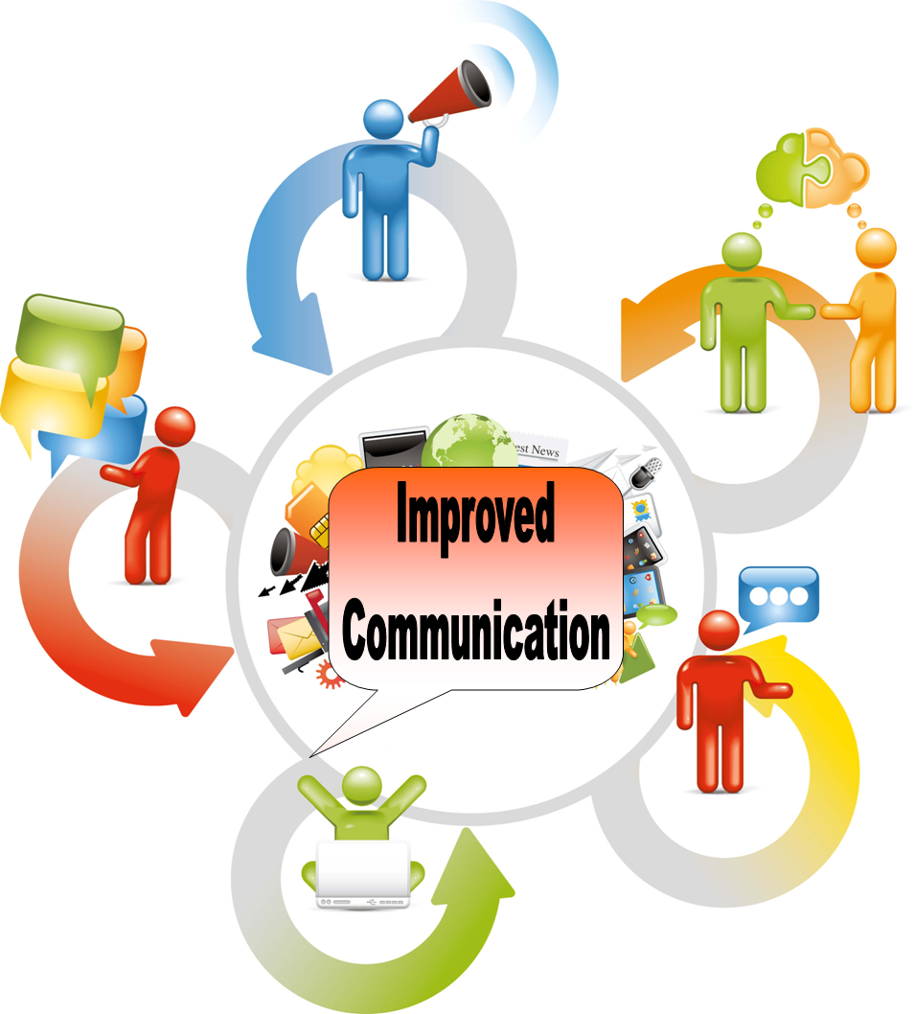
Notes:
Through our KISS exercise it became apparent that we need to continue to refine our communications with our members.
Goals:
ensure that the information is accessible, clear, concise, and easy to find
communication becomes regular, anticipated, and consistent
Focused on what the members need and want
Building capacity around telling our story
We want you to have access to ‘one source of truth’ and make it the gold standard by which we dialogue with you.
This year we will be working on re-developing our communications in conjunction with Operations to create a National Communications Strategy.
Some highlights we are working on:
Intranet project charter completed in collaboration with ED Grant. Next steps are working to define costs and timeline
Timely ‘Inside the Boardroom’ updates will now occur after each Board Meeting in both written and video format
Facebook updates will be posted exclusively to ‘the Link’ to keep you informed in a place where you can find it
Linked attachments on Board related topics will be included in e-blasts and cybernews
As an added incentive we will be hiding a few ‘Easter Eggs’ within the communications; keep posted to learn how you can engage with us to further your Kin experience
Investigating ability to upgrade web based information in a mobile responsive way

Slide 6

Notes:
To be the first choice service organization in Canada we need to keep building Leaders
There are two sides to Building Leaders: Operations and Governance
Operations builds members in personal development for all levels of engagement in Kin
Kin-U, DLS, Governor Training
Shapes programs through engagement on operational committees
Builds pool of highly knowledgeable and skilled Kin to engage on a more strategic level (ND applications)
The Board has moved to qualification based on skill, knowledge and attitude and you have elected Directors who have attained a high level of personal development both through Kin and in their life/work experience.
Board evaluation and education continues to develop skills
Increased efficiency, effectiveness, and impact on meeting Strategic Plan and visioning future
Empowers Operational Leadership to bring further programs and development for our clubs
This is a cycle that feeds each other:
Members are developed within the Association for varied leadership roles (club, zone, district, operational committees, and ND’s)
Visionary Leaders on the Board guide the Strategic Plan which impacts the further development of the membership
To have value we must invest in both our members and our leaders.
ED Grant has been empowered to continue populating Kin U with leadership building programs
Board Source: online resource for non-profits designed to empower boards and inspire leadership will be used at Board level to hone expertise
If you are interested in a role as one of our Next National Directors, please come and speak to me, or any other member of the Board. We will be happy to show you ways you can guide your continued education to prepare you for advanced leadership roles.

Slide 7
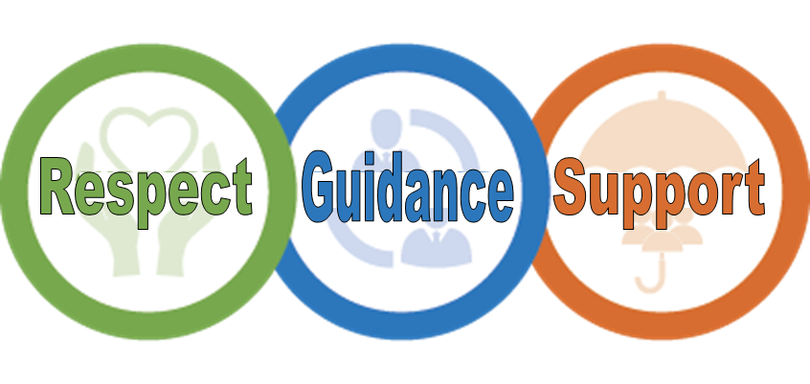
Notes:
Speakers Notes:
Through our KISS and Future Forward exercises, we heard many comments relating to club culture.
To reach our strategic objective of becoming the first-choice service organization in Canada we need to ensure that we have the tools in place to provide guidance for clubs, and foster an environment of support and respect.
Operations has provided the members with a road map to support club culture through development of member programs and services executed by HQ staff and National Committees.
The National Boards roll in supporting club culture is through Review, Update, and Development of Policy and Procedures:
Some of our policies
Rules of order
Voting
Not in Good Standing
Code of Conduct and Community Standing
Bullying and Harassment
Conflict Resolution
We are continually working on reviewing and improving the clarity and implementation of the Policies and Procedures of the Association.
By adopting the policies laid out by Kin Canada, Clubs have the guidance and support they need to tackle difficulties that may arise in a consistent, respectful, and effective way.
Please ensure your club is aware and often reviews the Kin Canada Policies and Procedure Manual for updates to all policies.
Front page of P&P outlines current changes to the manual

Slide 8

Feedback?
…FeedFORWARD!
Notes:
Interactive Engagement:
Feedback?....FeedFORWARD!
We have had the opportunity to get your feedback over the last few months to help us assess your needs. Today we want to explore the concept of FeedForward - a solution based practice that will help us to get ideas on what we could accomplish and what we could do at to meet the needs of clubs.
This is your chance to brainstorm; a chance to give us your best ideas on how to continue to meet the needs of clubs.

