Slide 1
National Education and Training Committee
New
Member’s
Orientation
Revised March 2017

Slide 2



Slide 3

What you can expect from Kin
Personal development, leadership skills, and educational opportunities
Lasting friendships
An opportunity for families and individuals to work and play together to make a difference in your community
Pride in being a member of the greatest all-Canadian volunteer organization

Slide 4



What Kin Expects from You
Active involvement in meetings, work parties, projects, and fundraisers to the best of your ability
Family Work Kin
Contribution of annual dues as determined by the club
Honesty and integrity
A willingness to grow, learn, make friends, and have fun

Slide 5
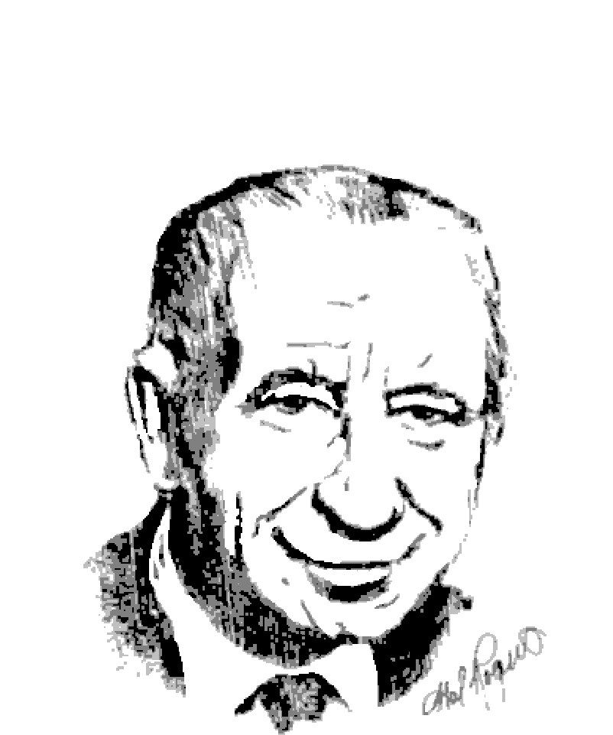
Founder Hal
Founder Hal Rogers, O.B.E., O.C.
WWI Veteran
Declined by the Rotary Club
Kin Canada was born February 20,1920 in Hamilton, Ontario
Notes:
Founder Harold Allin Rogers, OBE (Order of the British Empire) and OC (Order of Canada)
Born in London Ontario in 1899, Founder Hal started his working life in a bank prior to moving to Hamilton to join his father’s plumbing sales business.
Following the outbreak of WWI, Hal enlisted at the age of 17 in 1916, serving with the Argyle and Sutherland Highlanders. He was gassed at Passchendaele and later wounded by shrapnel at Amiens and for the rest of his life carried German steel in his right leg.
Upon his return to Canada in 1919, Hal rejoined his father’s plumbing business and applied to join Rotary Club.
Since Rotary had a rule that you could only have one member of a profession as part of a club, and Hal’s father was already a member and a plumber, Hal’s membership was rejected.
Hal decided to start his own service club to preserve in peace, the ideal of service to Canada. Kin Canada was born on February 20, 1920 when Hal and 11 young men met for the first time at the Namking Café in Hamilton Ontario.

Slide 6
Kin History
1920: Kinsmen started as a young men’s service club
1964: Partnership with Cystic Fibrosis
1978: Peak membership of 24,225
1983: Kinettes full partners in Association
1995: First Kin Club
2003: Became Kin Canada, new crest, single leadership
2010: Portraits of Honour was approved as a National Project

Slide 7
Motto, Vision and Values
Motto:
  Serving the Community’s Greatest Need
Mission Statement:
  Volunteers enriching Canadian communities through community service, leadership, and partnership.
Values:
Excellence, Integrity, Accountability, Compassion, Pride, Fellowship, Inclusiveness
Notes:
The Mission, Vision, and Values are reviewed regularly by the National Board of Directors to ensure that they reflect our Association and its goals as society changes.
The last revision was in 2014.

Slide 8
Objects of the Association
The Objects of the Association shall be to promote & direct service work through fellowship amongst its Clubs and their members, to the end that:
Members of the Clubs may enjoy personal development through the Association
They may be improved and educated in modern business and professional methods and ethics
The involvement of all in the enrichment of their community may be stimulated
A spirit of co-operation, tolerance, understanding and equality among all nations and peoples be fostered and that unity of thought and purpose throughout Canada be established toward this goal; and,
They shall serve their community’s greatest need.
Notes:
Attendees will not be able to read this, so you’ll need to read it out loud to them…or have them take turns reading

Slide 9
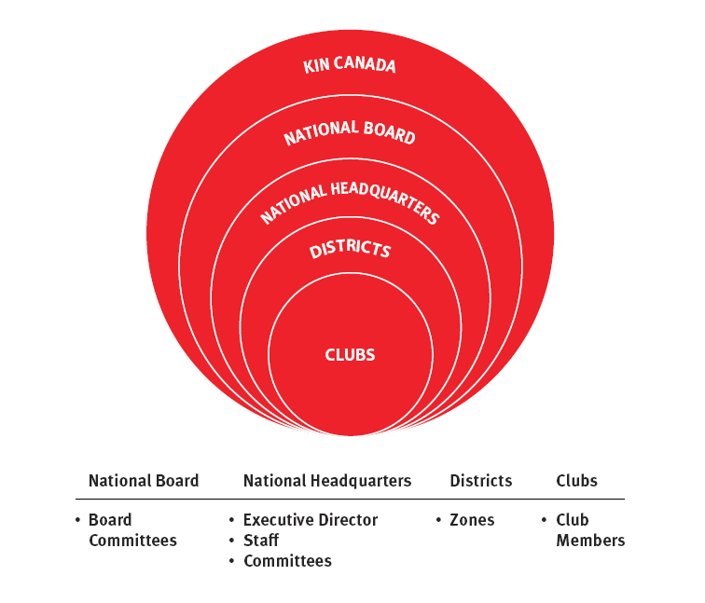
Structure of the Association
Notes:
Kin Canada Association
AT THE CORE
The clubs are the actual charter members of the Association. Individuals are members of their clubs.
Districts are extensions of the national body, created to help manage and administer the affairs of clubs regionally. There are eight districts, each made up of a differing number of zones. Zones were created to further assist with the direct support of clubs on a more local basis.
Governors are the administrative heads of their districts, responsible for the functions of their district council and the well being of their district. They are accountable to the ED for their progress on Association goals, but also answer to their members on district issues.
The Executive Director must determine how to achieve the objectives set out by the Board and is therefore responsible for all operational aspects of the Association, gathering advice from staff, committees, district leaders and members.
The ED employs staff, who use their professional skills to further develop and execute strategic initiatives, as well as provide operational support to member clubs, individuals, district teams and the Board. The Board does not direct staff.
Staff guide, coach and direct national committees. Our committees in a sense act as ‘unpaid staff’ to carry out work that is over and above the capacity of staff, while adding members’ perspective.
The National Board of Directors is made up of individual members of clubs, placed in office through (nominations at District level) and or elections at national convention. Their main job is to chart the visionary direction of the Association. They then translate that into policies that set out our objectives.
The Board may create committees and working groups to help carry out its work. Those committees may interact with various groups within Kin, but cannot direct any of these groups.

Slide 10
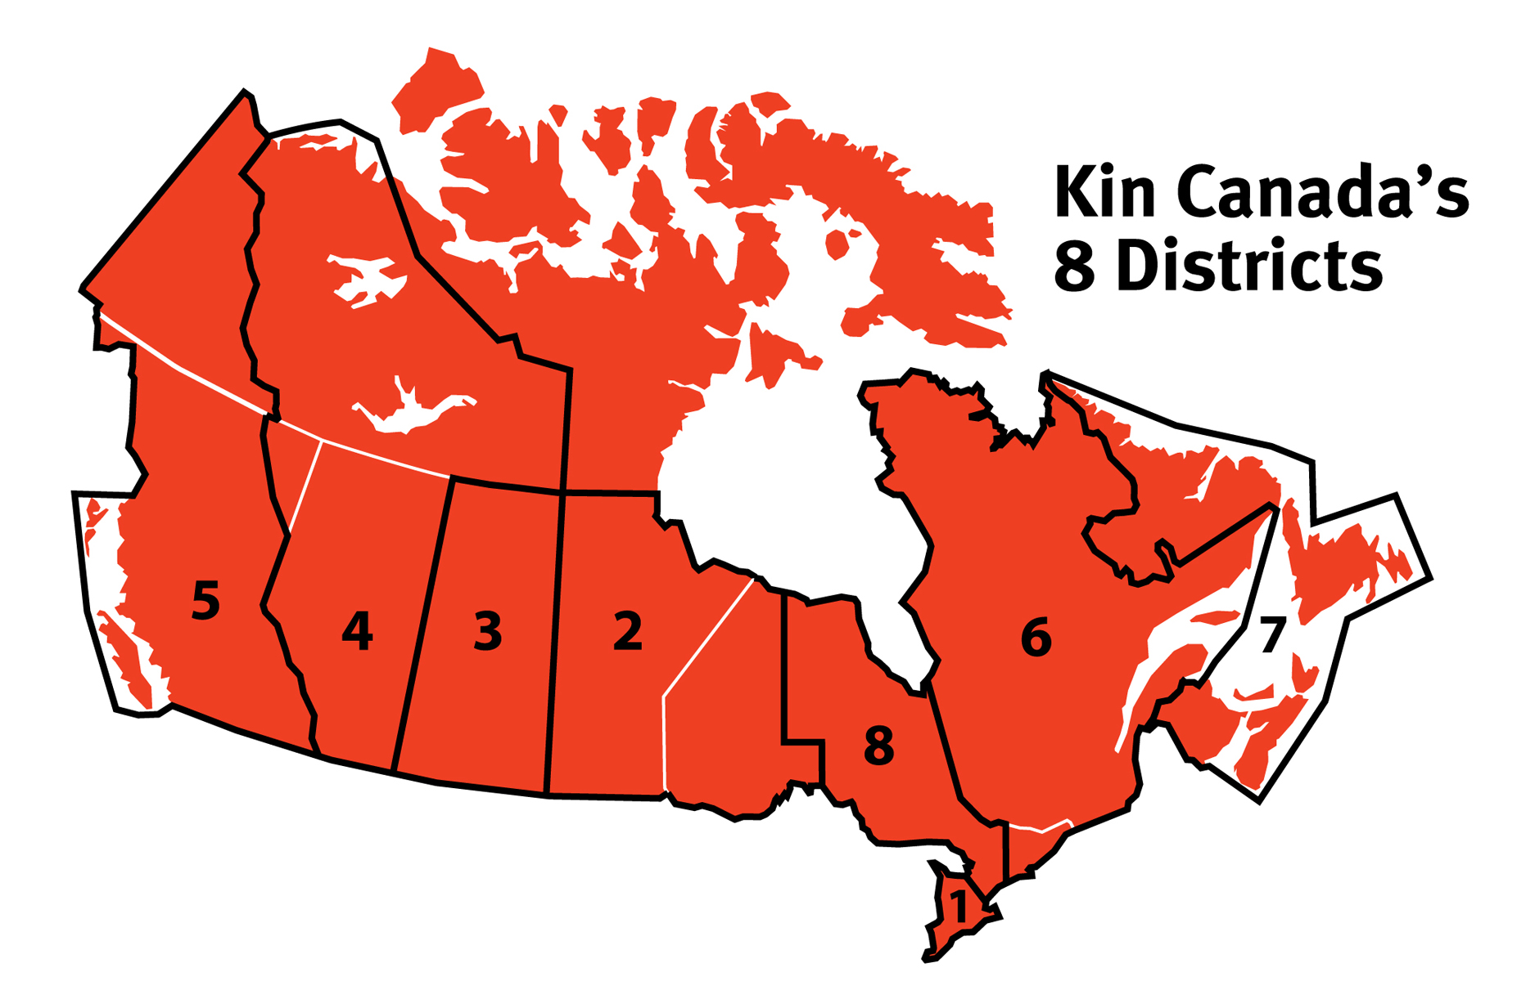
The Big Picture
Notes:
Review the Districts in Canada.
Many Kin – even our new leaders may not understand where the various Districts are located.
Geographically speaking which is our smallest District – 1; Our largest – 4
Explain why the order on the map is not aligned in geographic order. (D1 where the first clubs were formed.)

Slide 11

Where do you fit in…
CLUB MEMBER: THAT’S YOU!
CLUB: Your club is…
ZONE: Your zone is…
DISTRICT: Your district is…
NATIONAL: All clubs are members of…
Notes:
Answer to the National question – the Clubs are the members of Kin Canada, individuals are members of the clubs.

Slide 12
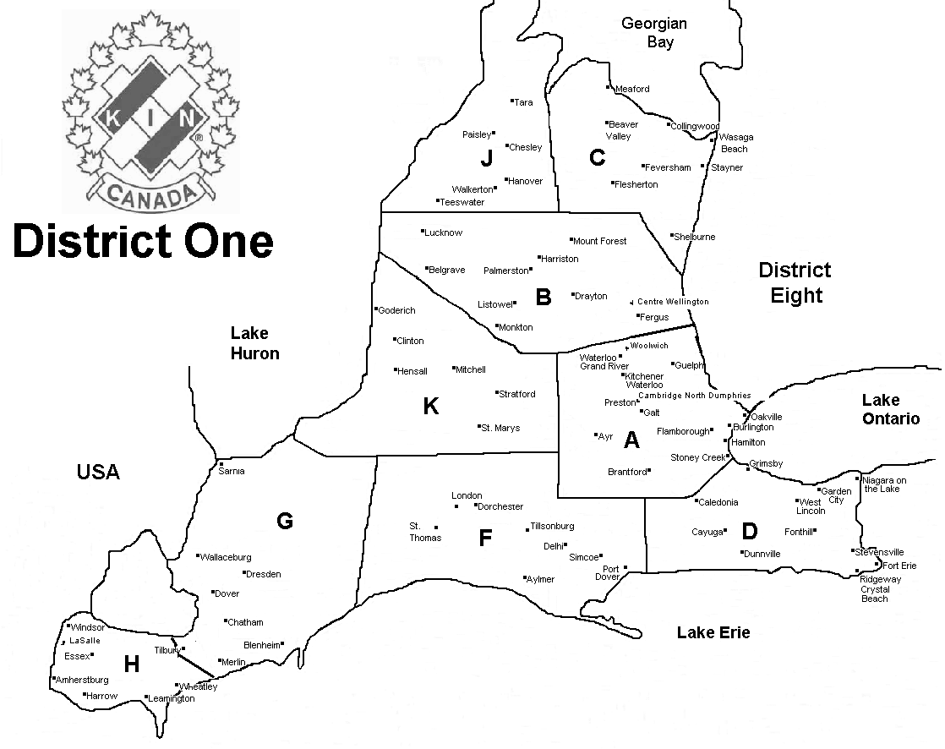
Where do you fit in…

Slide 13

Association Structure:
Who Does What?
National Board of Directors:
  Policy development and strategic planning
  Coordination of activities of Board committees
Notes:
Currently made up of:
National Vice President
National President
Past National President
Eight Directors

Slide 14

Association Structure:
Who Does What?
National Headquarters in Cambridge, ON:
  Day-to-day national operations, financial management
  Member services, including publications
  Marketing, media and public relations
  Management of National committees

Slide 15

Association Structure:
Who Does What?
District Governors:
  Leadership and day-to-day administration of district
  Policy implementation and communication
  Ensure information flow between members and National
Notes:
Governors make up the National Management Team.

Slide 16

Association Structure:
Who Does What?
Deputy Governors:
  Leadership and administration of zones
  Ensure information flow between clubs and District Governors

Slide 17
Association Structure - District
District Council includes:
  Governor(s)
  Vice-Governor(s)
  Past Governor(s)
  District Directors (Secretary, Treasurer, Membership, Service, Risk Management, Education, etc.)
  Deputy Governors
Notes:
The 8 districts define in their house rules, the structure of their executive with some districts choosing to have single leadership and some have dual leadership at the governor and deputy governor levels.
The Successful District Manual can provide you with more details on District administration.

Slide 18
Association Structure – Zone
Zone Teams include:
  Deputy Governor(s)
  Zone Directors (Secretary, Treasurer, Membership, Service, etc.) as required
  Club Presidents
Notes:
The Successful Zone Manual can provide you with more details on District administration.

Slide 19
Association Structure – Club
President*
Past President*
Vice President*
Registrar
Directors – Membership, Service, Awards, Communications (Bulletin), Education
*these positions are required by the government as incorporations, the National Policies and Procedures, and our national insurance provider
Secretary*
Treasurer*
Risk Manager*
Notes:
Although each club has an executive, the positions on the executive vary from club to club. At a minimum, clubs must have a president, vice president and secretary treasurer. Kin Canada best practice - all clubs should have a Risk Manager. All other executive positions are at the discretion of the club.
Past President position acts as a mentor an is to help the President when needed or does a job asked by the President.
President is responsible for running the meeting.
Membership Director is responsible for encouraging growth opportunities within and outside the Club.
Vice-President is responsible to replace the President if he/she is not able to.
Secretary - take accurate minutes of the meetings.
Treasurer - handles all the financial part of the club making sure everything is done by cheque and has 2 signatures per cheque.
Directors – clubs can have as many as they see fit to run their club. Standard is a Service director.
Bulleting Editor - creates your newsletter or brochure with happenings in the club, district and national .
Risk Manager – Works with Club to mitigate risk and to produce required incorporation, risk management and other mandatory submissions
Register - keeps track of who has been to meeting for attendance and attendance awards.
National Policy & Procedures section 2.0, subsection c, article VII states the minimum number of officers of a club shall be as follows: the president, immediate past president, the vice president, and the secretary/treasurer.
The successful club manual defines these positions in more detail.

Slide 20

Service
Kin Canada’s motto is:
  “Serving the Community’s Greatest Need”
Association has a proud history of service across Canada and around the world
Each club decides how to best serve their own community
Notes:
Kin clubs undertake a wide variety of local fundraising and service projects.
Its motto - "Serving the Community's Greatest Need" - means that each club determines how it will raise funds and how those funds will be spent in the community.
The Association encourages the autonomy of its clubs so that as many decisions as possible are made by its members at the club level.
Community can mean a great deal of things, you local community, your province, your country or even the wider world community.

Slide 21





Service
Nationally, we support:
  Cystic Fibrosis
  National Disaster Relief Fund
  Canadian Blood Services
  Hal Rogers Endowment Fund (Kin Canada Bursaries)
  National Day of KINdness
Notes:
It may seem like we’re really dwelling on the service aspect of Kin, but there’s a reason for that. We do a lot of service in our community – and that community stretches way beyond the boarders of your own village, town, city or county – your community is your province, your country and the world.
Since 1964, the Kinsmen and Kinettes national fundraising project involves supporting the work of the Cystic Fibrosis Canada (CFC). This year the Association's total contributions are expected to surpass $40 million for CF research and treatment.
In 1989, Canadian researchers discovered the gene that causes cystic fibrosis — CFTR, the first disease-causing gene to be identified, and at the time their discovery, touted as one of the most significant advances in the history of human genetics.
Because of the close partnership with Kin, the Cystic Fibrosis community held off announcing the find for a few days so that it could be announced live at Kin Canada's National Convention.
2014 marked 50 year of partnership with CFC.
National Disaster
Kin Canada has also been a long supporter of disaster relief nationally and internationally
Kin Ride to Low Tide
Hay West
BBQ Canada
Hal Rogers Endowment
Its purpose is to promote, encourage and sponsor educational programs and activities.
Canadian Blood Services
Partnership to raise awareness of blood donation and increase donations across Canada
National Day of Kindness
an opportunity to celebrate the founding of our association by promoting selfless acts of kindness
Kin are also active from coast to coast promoting a variety of national pride initiatives designed to give Canadians the opportunity to demonstrate that they are proud of their country.

Slide 22
Service
Districts
  Most of the eight districts will have their own individual focus on service, in addition to the National program

Slide 23
Kin Canada Foundation
founded in 2005 as the official charitable organization of Kin Canada
Clubs can use the Foundation as a vehicle for donors to receive tax receipts
The Foundation administers a number of programs including the Hal Rogers Fellow Award, 49th Parallel North and Kin ASSIST
Notes:
Programs
Hal Rogers Fellow:
• Recognizes members, alumni and non‐Kin who have made significant contribution to
community or country
• Proceeds from program go to permanent endowment fund to support Kin Canada
Portraits of Honour:
• Mural depicted 157 Canadians who died serving Canada in Afghanistan
• Mural toured Canada in 2011‐2012
• Raised funds for Military Families Fund to assist families of the fallen and personnel returning
with physical and/or emotional injuries
49th Parallel North Fund:
• Created to honour military personnel and first responders who died on Canadian soil
• Raises necessary funds to provide support to families of honorees, including assistance toward
post‐secondary or training expenses of family members
Kin ASSIST (program under development):
• Purpose – to provide support to individuals and families during or after devastating life events,
including: life‐threatening illnesses; hospital stays; vehicle collisions or industrial accidents;
house fires or other catastrophic events

Slide 24

Fellowship
Kin was founded on the basis fellowship
Kin activities help us to
Notes:
Kin was founded on the basis fellowship but the club soon found it needed more reason to be and so introduced service.
Kinsmen and Kinettes come from all walks of life, so you’ll enjoy being part of a diverse and spirited group. And, like most members, you’ll make lifetime friendships that extend far beyond your own club.
Have a whole lot of fun.
Although the Kin organization dates back more than 95 years, there's nothing old-fashioned about what Kinsmen and Kinettes do.
Activities and events are lively, interesting and fun.
Fundraising projects get you into the community, and they're always rewarding and entertaining.

Slide 25
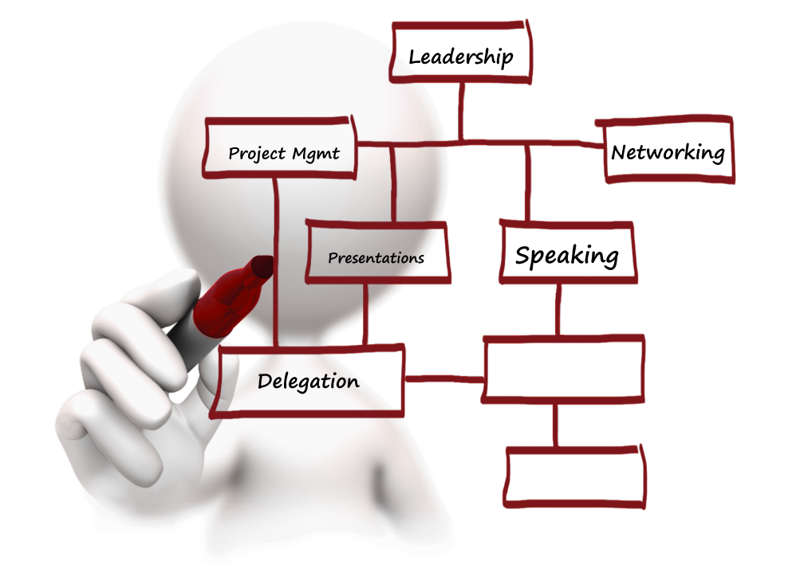
Personal Development
Kin members have opportunities for:
…
Notes:
Active involvement in Kin can develop personal traits you never knew you had.
Develop public speaking and presentation skills
Learn how to run meetings well and to delegate
Manage projects creatively, profitably and effectively
Network with other members, the community and the media
Develop ethical and practical business and “people” skills
Develop verbal and written communication skills
Observe how “the other half” lives and understand their own role in the community
It’s very satisfying to be a member of the Kin organization. You’ll be proud of the work you do for others and pleased with the personal benefits that result. You may become a better leader or more of a team player. You’ll find yourself more relaxed in dealing with groups; your presentation skills will improve, and you’ll become a better public speaker. Plus, you’ll have a chance to network with people from a wide variety of businesses.

Slide 26

Dues and Assessments
National
District
Zone
Club
Notes:
National Dues and Assessments are paid by clubs to cover the costs of administration and promotion of the Kin programs on the National, District, Zone and club level.
It is Clubs, not individuals, who pay a dues and assessment to belong to the Association. National Dues and assessments are an administrative cost of belonging to the Association. And while the amount is determined based on the number of members in a club, the club members aren’t necessarily paying that amount to belong to the club. Clubs set the amount they charge individuals to belong to the club. The two may or may not be the same depending on the administrative fee the club assesses on it’s service dollars.
These costs include items such as travel of National and District Officers, awards, National Headquarters operation, salaries of National staff, postage, telephone, liability insurance coverage, etc.
NATIONAL DUES and Assessments are based on a budget proposed by National Headquarters and passed at a National Convention. The expenses of operating Kin nationally is calculated based on the national roster.
The National Dues and Assessments Billing is calculated the first week of October.
National Dues are based off an average of a club’s membership from the prior year.
The membership numbers from each month will be added together and then divided by 12 to determine a club’s dues.
1st installment is due November 15th and 2nd installment is due March 31st.
( this is a new process )
Clubs pay District and zone dues according to the District and zone House Rules. Some Districts and zones have additional assessments to cover specific items. DISTRICT DUES are set in a familiar fashion to National but are approved in the budget at District Convention. Some zones have dues as well to help with the costs of the Deputy Governor.
Most clubs charge their members an annual fee to help offset the administrative costs of running the club. CLUB DUES are set when your club presents its annual budget to the members.

Slide 27

Club Meetings
General Meetings
  All members expected
Executive Meetings
  Elected officers
Committee Meetings
  Members organizing a project
Notes:
It is important that our members and leaders at all levels have an opportunity to meet with their peers to discuss problems and concerns, to exchange ideas and update information.
It is recommended that clubs have a minimum of one executive meeting per month. The president chairs all executive meetings and prepared the agenda for the order of business. These meetings are run with the same business format at general meetings. The majority of club business should be discussed at the executive meeting with reports presented at the general meeting of the club.
General meetings of the club include all club members including the executive and committees. At general meetings, the president usually appoints a Sergeant-At-Arms who assists the president in ensuring the meetings are orderly and undisturbed by members. This is accomplished through the assessment of penalties for minor infractions such as arriving late, no name badge, failure or observe club protocol.
While the Executive members are expected to attend Executive meeting, all members may also attend if they so wish.
Committee meetings would be held as needed when committee are formed.

Slide 28

Conferences and Conventions
Conferences and Conventions are how the association:
  Conducts its business
  Approves budgets and financial statements
  Shares information with its members at each level
  Elects its officers at each level
  Offers fellowship and educational opportunities
  Celebrates its achievements
Notes:
Members get to understand what happens in other clubs and at all levels (“getting the big picture”).
Good networking, personal development and fellowship opportunities.
A chance to see other parts of the country.
Incorporations are required to hold Annual General Meetings (AGM). To meet this need, the Association holds a National Convention during the month of August.

Slide 29
Conferences and Conventions
National Convention:
  Held in August
District Conferences:
  Fall Leadership Conference (October/November)
  Spring District Conference / Convention (May/June)
Zone Conferences:
  Spring Zone (February, March or April)
Notes:
Location of conferences and conventions will depend on which club is hosting the event.

Slide 30

Kin Rules of Order
Ensure order and control at meetings
Keep meetings brief and effective
Respects all members
We don’t use Robert’s Rules of Order
Notes:
Kin meetings are run using basic parliamentary procedures.
There are two reasons for this; first, it is easier to conduct business if a set of rules is agreed upon and, second, members are instructed as participants in the correct way in which to involve themselves in a parliamentary forum.
Meetings at every level are conducted according to Kin Rules of Order. Kin Rules of Order are a modified version of Robert’s Rules of Order.
Please visit Kin U to learn more about Kin Rules of Order.

Slide 31
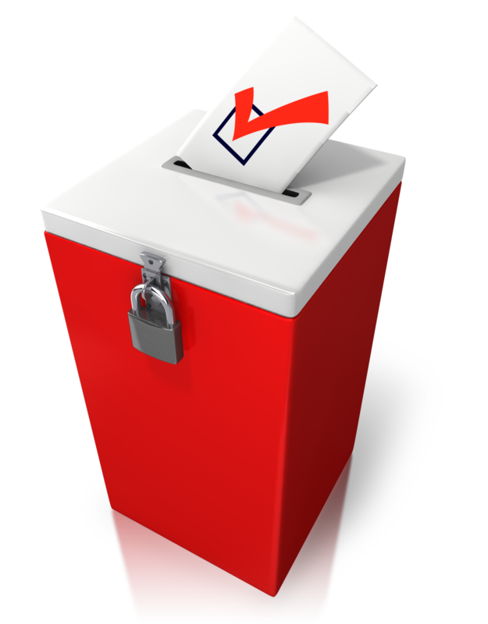
Club Elections
When
Nominations
Voting
Notes:
Elections are normally held between April 1 and May 15th with the newly elected club executive taking office on July 1.
The current executive should appoint a nominating chair and/or committee to bring a slate of officers to the club on Nominations Night. The committee should have at least 2 candidates for each office with the nominations published in the club bulletin or presented to the club membership electronically.
Voting is carried out by secret ballot. All members in good standing have one vote.

Slide 32
Club Finances
General Funds
  Used for club administrative costs, events for members, dues, awards, etc.
Service Funds
  All funds raised from the community that will flow back into the community
Notes:
As an Association we have 2 divisions General and Service. Clubs are required to maintain a minimum of 2 two bank accounts. One for General dollars and one for service.
General Division
General accounts is used for the everyday running of the club. Historically in the Constitution and by-laws, it stated that a club could transfer up to 15% of the “total net service revenues” to the General Division and pay the administrative fees out of a General Bank account.
This restriction was removed in 2003 when we replaced the Constitution and Bylaws with the General Operating Bylaw. Now clubs may pay these expenses out of a service bank account or they may transfer funds (often using a guideline of 15% of the total net service revenues)to a General bank account.
Service Division
Community Service Bank Accounts are accounts where all service requests are met through the funds in this account. These funds are what we raise through public.

Slide 33

Awards
To recognize achievement and engagement within the Association
Available individually as well as at
  Club
  Zone
  District
  National
Notes:
Our Association has many awards.
These awards are for districts, zones, deputy governors, clubs, presidents, individual members.
National Awards are found in the Award brochure on the Kin Canada website.
District Awards are found in your district house rules.

Slide 34

Classes of Club Membership
Officially - Active Members only (individuals for which clubs are assessed dues), as per the National bylaws and procedures
  Life Members, the Association’s highest honour, award
  Honorary Members – should be defined in club house rules
Notes:
According to the General Operating Bylaw, Clubs are the members of the Association.
Thus all current and/or historical references to the titles of “Life Member,” “Associate Member,”
or “Referendum Member” are not within the scope of “Member” as herein defined within the General
Operating By-law.
Further,
Active Members: Are a minimum of 19 years of age, are of good character and community standing and work or reside within the territorial limits of the club. The club is assessed a dues levy for them. (There may be an exception when it comes to campus clubs – age may be lower)
Life membership: Is an award, bestowed on one who has been a member for at least 10 years and who has served his/her club and the community in a manner deserving outstanding honour. Either a past or present member of the club can be elected to life membership. She/he enjoys the same privileges as an active member, including paying dues, coverage from liability insurance, voting and being allowed to run for offices and awards.
Active Life Members vs. Life Members
Honorary Members: The club must define what these members are entitled to.
Normally they are elected for one year to recognize some distinguished service they have performed for their community or club. She/he does not pay fees or dues and is entitled to all the privileges of a club except to hold office, vote, and compete for awards.

Slide 35
Meeting Formalities
O’Canada
Kinsmen, Kinette, or Kin Grace
Kinsmen, Kinette, or Kin Song
Objects of the Association
Sergeant-at-arms
Protocols
Notes:
We open our meeting by singing O’Canada
This is followed by the Kinsmen, Kinette or Kin song
The Objects of the Association should be read or recited
We say Kinsmen, Kinette or Kin Grace before we eat
The sergeant-at-arms assists the club president in ensuring that meetings are orderly and undisturbed by members. This is accomplished through the assessment of fines for actions such as being late, failure to observe club protocol, missing name badge.
Protocols for whom and why? During their term in office our Association’s officers will make many official visits with the members as part of their contribution to our Association. It should never be forgotten that they are volunteers as well. What types of protocols there is to follow. Protocol is used for guest outside of our Association as well this is to show our respect for the person.

Slide 36
National Resources
Kin Canada National Website www.kincanada.ca
  Resource Library – look for the Successful Series of manuals
Kin Magazine
Kinnections
Cyber news
Kinbook.ca
Kin U
Notes:
Kin Canada National Website: www.kincanada.ca - resource library – successful manuals
KIN MAGAZINE - Official publication of Kin Canada, KIN Magazine is published in print three times a year (February, June and October) from the editorial office in Cambridge, Ontario. Online editions are posted during the months of April, August and December
KINNECTIONS - National staff have designed this newsletter to connect with you, the member, and reduce the amount of literature sent out in club mailings.
Cyber news is sent to members via email twice monthly with updates and links to important information for all members.
KIN U – online learning platform (personal/leadership development) www.kin-u.ca

Slide 37
Other Resources
District Websites & Newsletters
Zone Websites & Newsletters
Club Websites & Bulletins
Sponsors and Mentors
  Experienced members of your own or other clubs
Notes:
District Websites: Stay up to date as to what is happening
in each District. You can gain access to each District
Website by going to www.kincanada.ca - log in and then
click on District Websites.
Club Websites: Stay up to date as to what is happening in
individual Clubs across Canada. You can gain access to
individual club sites by going to www.kincanada.ca - Log in
and then click on Club Websites
CLUB BULLETINS - Published by the club to inform a
membership of club’s activities and general information. A
committee chaired by the Bulletin Editor or individual
members can produce the bulletin.
ZONE AND DISTRICT NEWSLETTERS - Published by
Zone and District Executive Officers to inform members of
activities at these levels and share information.

Slide 38


