Slide 1

Notes:
Welcome and introductions of the NETC present

Slide 2

Notes:
National Education Committee consists of 5 members currently and a HQ staff liason
PNP Melodie LeMoeligou, PNP Lee Burry, PND JM, Brian Cooper aka Coop, ED Grant and myself
Our terms of reference as a national committee is 2 fold
We are to ensure Kin Canada’s training and education programs contribute to the development of it’s members ( in such a way that their lives are positively impacted both internally and externally to Kin
To prepare members to fulfil leadership role within their clubs, zones, district and national level.
Decribe briefing what will be covered off today..
5 w’s… and the How in a short tutorial

Slide 3

Learning Management System
Educational pieces
Lots of creation
Providing education for all levels of Kin
Room for growth
Notes:
What is Kin U ?
Learning Management System ( sometimes referring to or you may have heard the term: LMS )
What kind of content is on Kin U ?
Educational pieces varying from short vignettes, longer tutorials, training modules, and videos
What is being done
Lots.. Lots of creating/checking/growing
What should be done
Ensuring we are providing all levels of educational pieces
What is to come
Room for growth, the sky is the limit to what we can address for all education Kin and Non-Kin related.

Slide 4

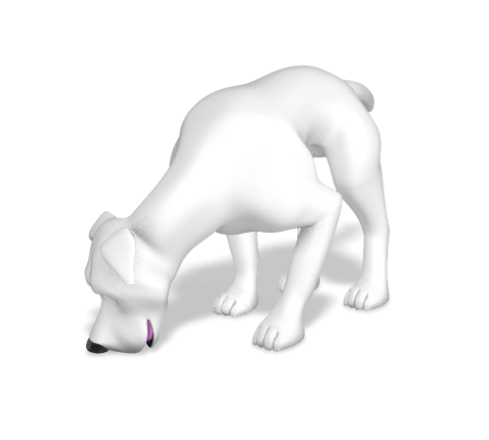
Notes:
Why do the members want/need this content?
Unable to find education
Asking for it for a while now
Kin on the go
Access at your fingertips
Staying * up with the times* in the regard to education
Online is the future
Why do it this way
Once researched – this was the best option
Easily accessible for all members – via computer and smartphones/tablets
Why is it there

Slide 5


Notes:
Who is the content for?
All members of Kin Canada, Kinsmen and Kinettes; new to seasoned
Always something to learn as things are always changing
Who should be doing it – everyone !!
Who else can do it
Just Kin Canada members can gain access to the Kin U platform

Slide 6

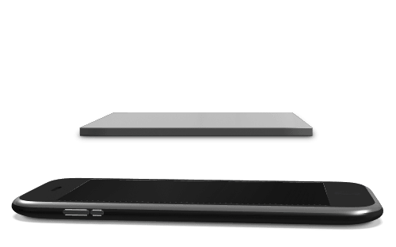

Notes:
Where will the members receive the content?
Kin-u.ca
Accessible by computer/tablet/smart phone

Slide 7


Notes:
When will it be delivered?
Education is available this way at any time.
24/7
When you need it /require it/have the time for it
When can it be done/ When should it be done

Slide 8


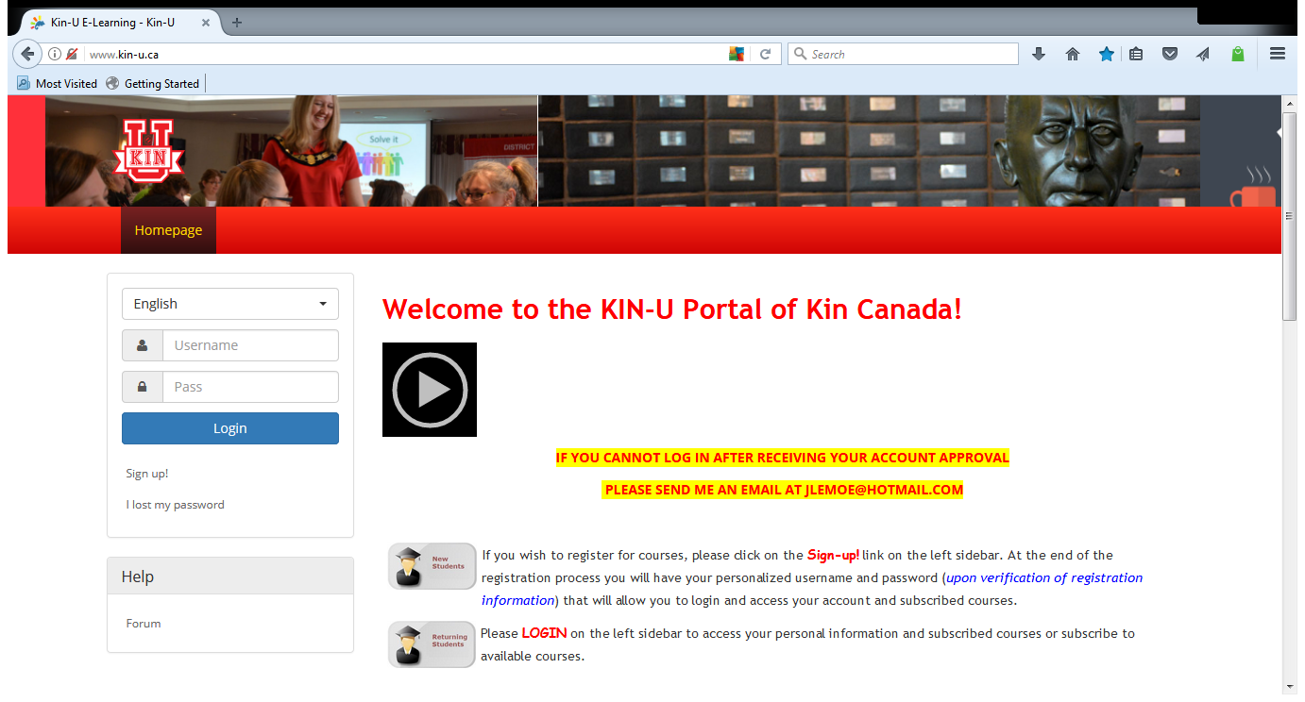
Notes:
How to do it
How it is done
How should it be done

Slide 9
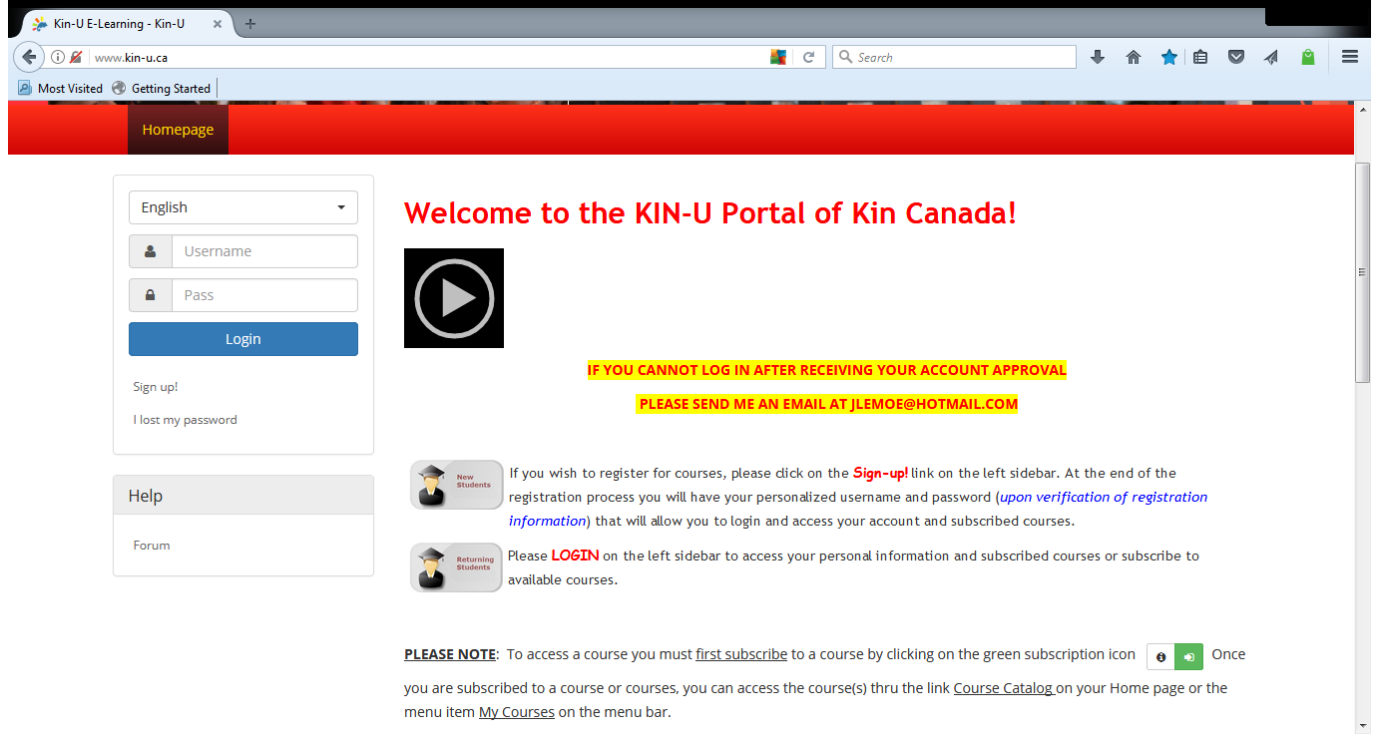
Notes:
First step as a first timer:
Sign up on the left hand side of the screen
A registration will be emailed back to you for you to gain access to Kin U from the Kin U Administrator
Timing: roughly a day.. May be a day ( or two )
Once there is it suggested that you first visit the profile section and set up your Kin U profile under the edit profile tab or title .
The Profile with walk you thorough various things – somethings asked: password set up, questions in regards to chatting/notifications etc
You can go into your profile and update/ make changes etc

Slide 10
Notes:
Now that you are registered.. You can click log in any all future visits to Kin U.

Slide 11
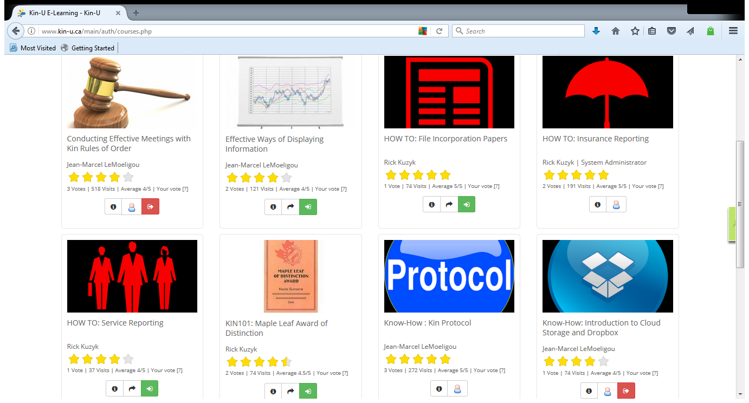
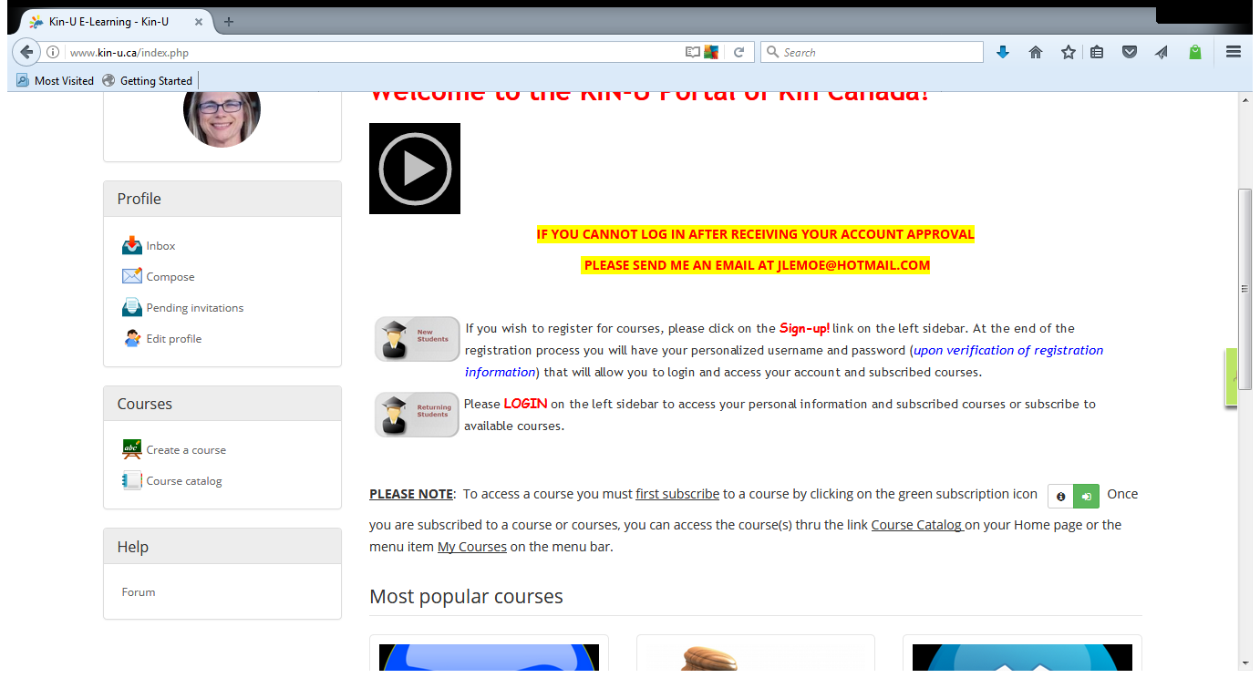
Notes:
Course Catalog
PLEASE NOTE: To access a course you must first subscribe to a course by clicking on the green subscription icon Once you are subscribed to a course or courses, you can access the course(s) thru the link Course Catalog on your Home page or the menu item My Courses on the menu bar.

Slide 12
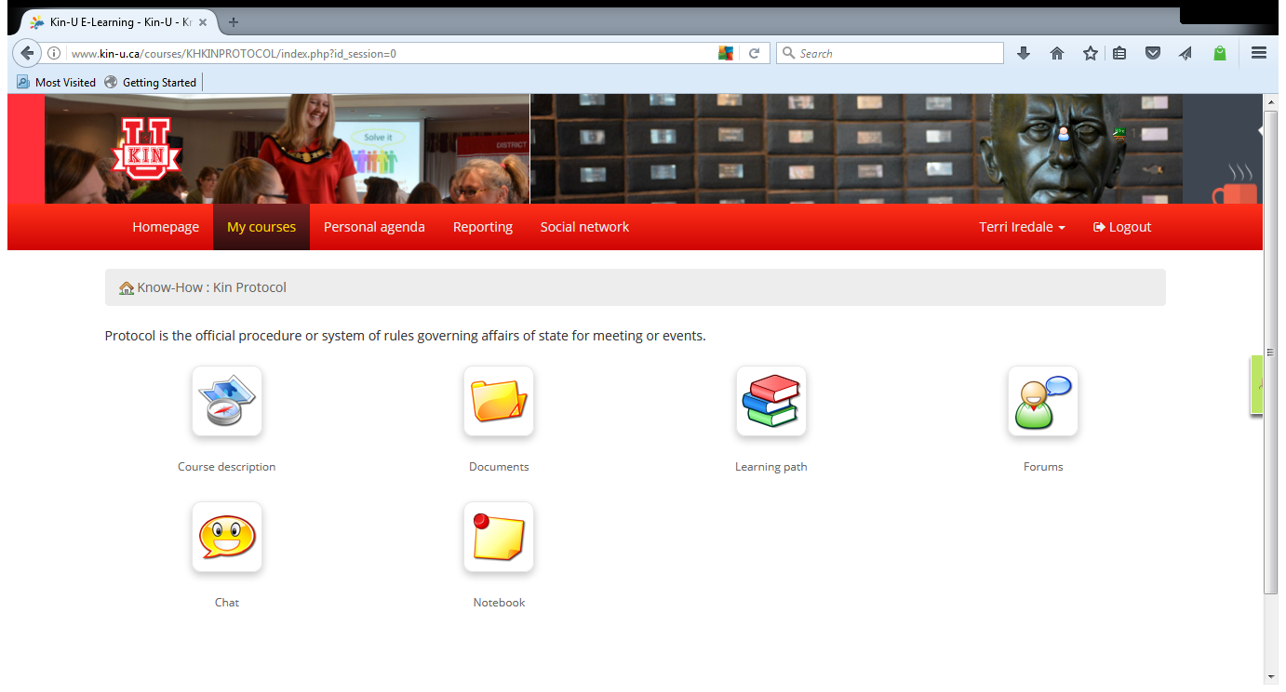
Notes:
Click on Course: Kin Protocol
Course Description Icon:
Describes the course description to you
Documents Icon:
Will provide you any course notes in this case protocol notes in a pdf ( that you can then copy, download and/or preview)
Learning Path icon
When you click on this icon it will take you to the actual tutorial of that course

Slide 13
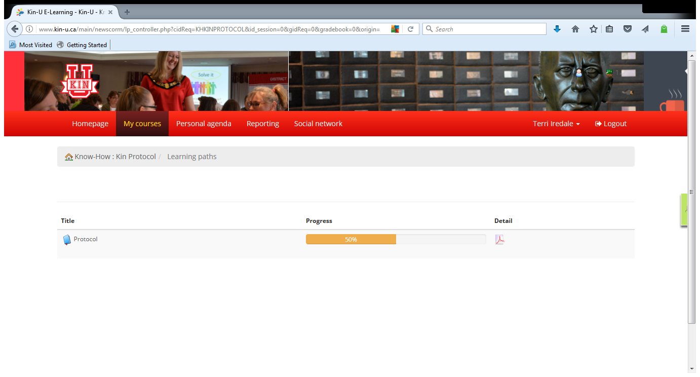

Clicking on the Learning Path icon will bring you to the learning material
Notes:
Learning Path Icon

Slide 14
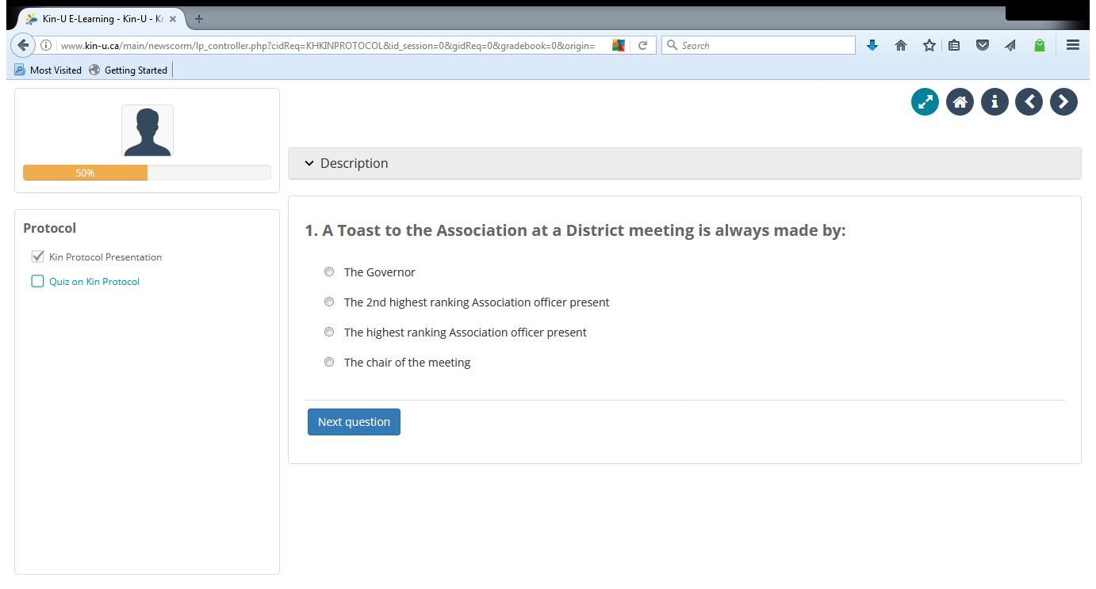
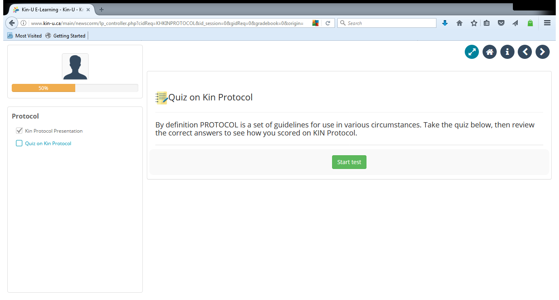

Notes:
Some courses also have a Quiz associated with the Educational course.
By clicking on the quiz you will then access the online course and then proceed to the start quiz page

Slide 15
Congratulations on completing a course
Move onto another
Check back often
Chat with friends
Engage in forums

Slide 16

Your feedback is important
Talk to us
education@kincanada.ca
Notes:
Please promote the feedback for your session by the survey monkey link and the paper evaluations in each session room
There are tickets in each session for delegates to be entered into a draw for attending ( delegates to place those tickets into a box on the National Convention registration desk ) Draw will take place on Saturday
www.kincanada.ca/faqs
Please promote either the “ ask the experts bottom “ on the National website if it pertains to your committee, or provide a contact email address depending on your presentation ( add into this slide accordingly )

Slide 17


