Slide 1
Executive Director
Grant Ferron
District 1
Fall Leadership Conference

Slide 2

Where are we going?
Road Map
Members Appreciation
Education and Training
Service
Build Strong Clubs
Marketing & Communications
Notes:
Our Road Map focuses on five key areas of Kin Canada’s operations. Each area, in a more complete form, provides a year-by-year list of specific tasks that will be completed to bring us to the destination. In its entirety it is over 20 pages and it continues to grow as we introduce more detail.

Slide 3
Member Appreciation
Honouring a Job Well Done
Personal Milestone Recognition
National President’s Commendation
Certificate of Achievement (Growth)
Club Milestone Recognition
Personal and Club Honours
Notes:
3rd Party Recognition
MARCOM Connection

Slide 4
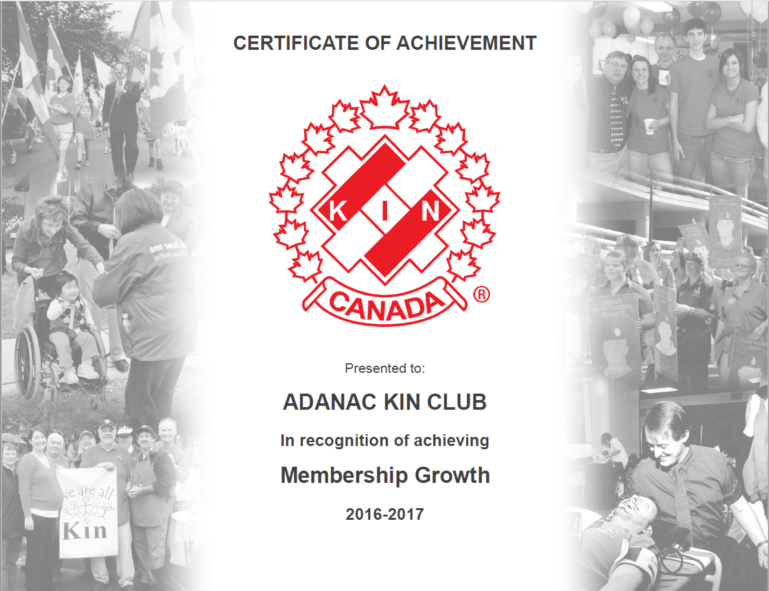

Slide 5
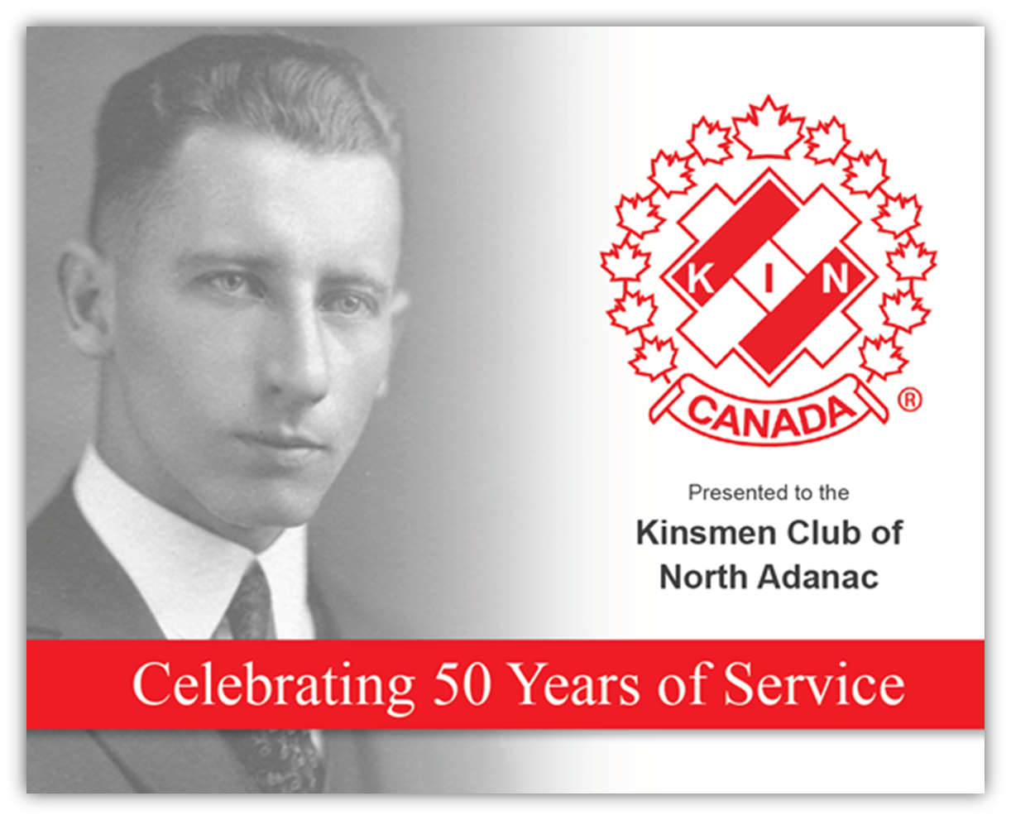
Notes:
This year we will be launching a Club Milestone Recognition Program where by Kin Canada will automatically acknowledge significant Club Milestones with a certificate and letter.

Slide 6

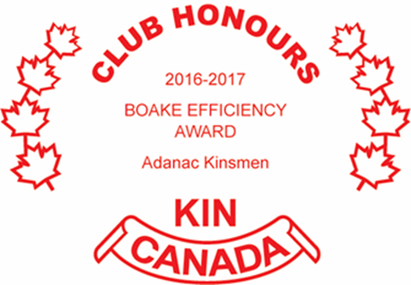
Notes:
If we make a big deal about this stuff then it will become a big deal.

Slide 7
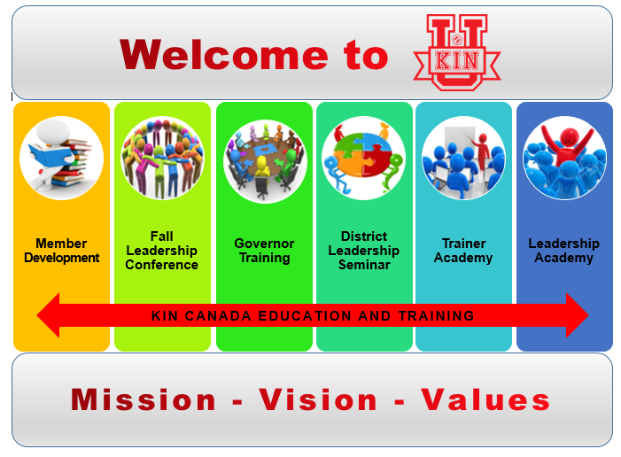
Notes:
Last year we introduced Kin-U which is both the umbrella for everything Education & Training and our Learning Management System.
This graphic represents the Kin-U umbrella from which the NETC derives its mandate.
We introduced a lot last year and like you, we are very anxious to see more productivity in this regard.

Slide 8

Education and Training
√ Kin-U Training Structure
√ Speechcraft
√ E&T standards
√ Conflict Resolution
Kin-U
Risk Management
Governor Training & District Leadership
Notes:
The excitement for the direction of Education and Training is heading has been felt loud and clear since we first announced our ambitious plans last year. While the waypoints have been slow to come this year, there is some very important progress being made in the laying of a firm foundation for which Kin-U will be built.
There is little room for mistakes and we must ensure our output is quality driven.
Last year we announced the partnership between Toastmasters International and Kin Canada to bring to life Speechcraft. We honour the efforts of Harry Kingston who unfortunately passed away just a number of weeks ago. The inaugural course led by PNP Melodie Lemoeligou was completed this past spring and the we are ready to “go” with both facilitator and participant resources completed.
As stated last year, we desire to see more standardized training materials used across the Association. Conflict Resolution is a great example where we have now established our preferred model and presentation of a Conflict Resolution model. This model has been approved by the authors for use in Kin Canada. We express out thanks to the Alberta Government for that permission.
Speechcraft and “Let’s talk” are two great examples where we will seek out those resources that our members will find useful on a personal and professional level.

Slide 9

Notes:
Our loftiest ambition is also our most challenging and that is the building of the Kin-U brand. We are challenged by limited human resources…BUT…building our capacity is a priority.
A good amount of work went into defining the Kin-U Training Structure, a standardised Program Outline and Course Summary. Also created were presentation standards. While these may seem trivial, the are critical to building the capacity we need to be successful.
The learning management system has had numerous “test flights” with very encouraging results and a full launch is eminent. But it will take a very focused effort to get it in full flight.
As an example, we are just a few proof-reads away from uploading a five course Risk Management Training Program. This program contains 5 modules that will help all members, including District Risk Managers, understand and use sound risk management practices. Members can watch the presentations and then take some quizzes to help them verify they understand. We should be getting to a point that these courses become mandatory for all those who manage risk management at any level of Kin Canada.
Kin-U is boundless and as you see from the road map, a critical element to Kin Canada’s future branding.

Slide 10
Service
  √ Service Reporting
  √ Introduction of a Project Database
  Expertise in Community Development
  Exploration of new partnerships
  Increased Relevance
Notes:
To start, this year we had 77% of our Clubs report in with their numbers. A nice increase over last year. Thank you to all the hard work by both Clubs and our Service Directors to make that happen.
Headquarters moved forward with an introduction of a “projects database” that captured 50 established projects. The full version is being launch in the coming days, enabling the Association to catalogue the countless projects that exist and the format enables Clubs to access this data.
We are embarking on a path whereby our expertise as a service associations will reflect current models for community development. We don’t expect our Clubs to become experts, but we should ensure we have that expertise on hand to leverage our collective assets to live our Mission. This will be reflected in our next hiring of National Projects Coordinator.
Our pursuit of relevance will take us on explorations into new areas where the need may not be being met. MyClassNeeds is just one example where we can leverage two organization’s assets to meet a need in ways that we neither can do alone.
Our service work is incredible. But we are not telling the whole story and this threatens our ability to sustain relevance. Relevance is a commodity and we must treat it accordingly. Inclusion and diversity are two examples that can serve the Association well AND dramatically harm us if not taken more seriously.
Many times within the overall Road Map, the various departments intersects with Marketing and Communications. Never so much is this truer than with our Service Road Map. Telling our story well and often will significantly impact almost all aspects of Kin Canada. There is no fake news here. We have great stories that need to be leveraged so our relevance and ability to serve the Community’s greatest needs can be more fully realised and enjoyed by our members.

Slide 11


Slide 12
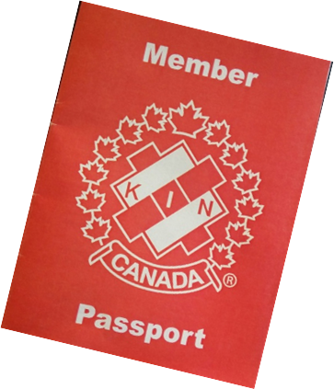
Build Strong Clubs
Build Strong Clubs
Mentoring Program
New Member Passport
Club Health Assessment
District Membership Directors
Exit Surveys/Folded Club Follow-up
Notes:
Last we launch a number of bits and pieces related to building strong clubs and the Club Support Committee had a very productive year.
The Mentoring program for new members has been fully implemented and we have begun to recruit mentors. While that gets rolling, we are in development of the training components to help make great mentors greater. We anticipate that in place, through Kin U by mid-Fall. Currently we have 22 mentors.
Showing our newest members that best and coolest elements of Kin should not be left to happenstance. The Club Support Committee developed a passport that is a resource for all new members and something they work on with their mentor and or own their own. The passport has and authentic look and feel. It is no doubt a life-long keepsake.
The Club Health Assessment underwent some beta testing and has now been officially launched. This tool enables clubs to self diagnose areas that require attention. The Committee even went as far as providing an on-line survey template that can be used by Clubs to collect the data – more enhancements are on their way.
I am very pleased to see the network that evolved through the initiative of D4’s Rick Kuzyk. We knew a good thing when we saw it and quickly ensured he had the support form HQ. We also looked at the role of our DMDs and recognized there was a huge gap in understanding throughout the association. We started to fix that through the development of the DMD Wiki/Handbook. As well, District membership Director.
The Committee also templated member Exit Surveys that can be used at both the Club and District level. Exit Survey’s provide a wealth of information that when used correctly, can “reset” a Clubs culture.
Lindsay King has also been following up with Clubs that folded this past year to conduct an exit survey with them as well. The focus is on determining what went wrong and what could have been done to prevent the folding of the charter. Most Clubs have willingly participated in this conversation.
We should be pretty pleased with the work to date of this Committee and there is more on the horizon, but for the time being the focus is on ensuring these resources and initiatives are properly maintained, enhanced and promotes.

Slide 13
Marketing and Communication
MARCOM
Notes:
Intranet
Website
Blogging

Slide 14
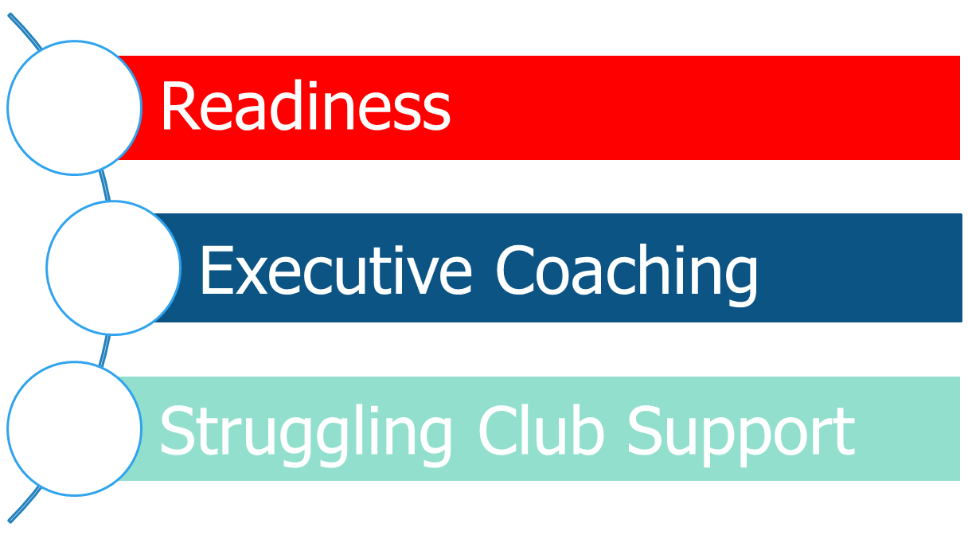
Final Thoughts

Slide 15
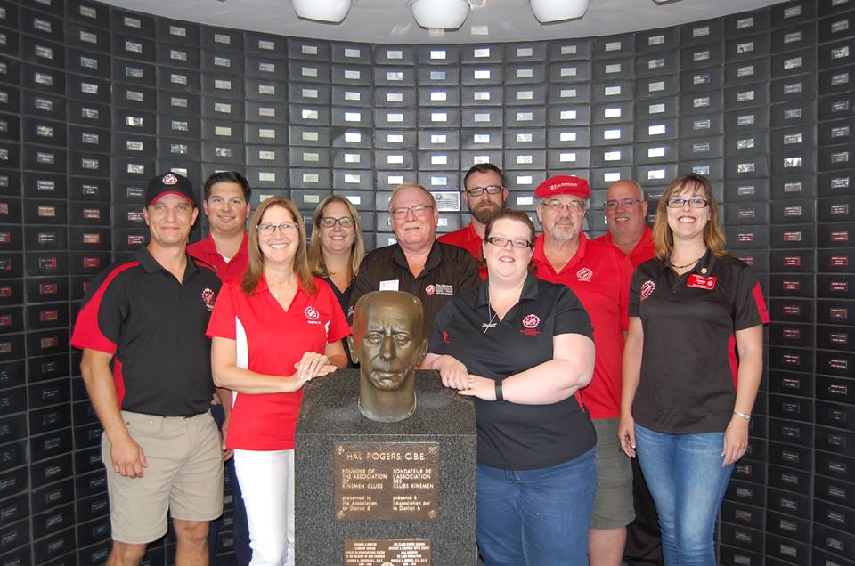
Governor Readiness
Notes:
Having now observed two terms of Governors there are some things I think we should be doing better to support them in their role. There is a very narrow window of opportunity for Governors to be effective and the biggest challenge they have is maintaining focus on being a leader.
Over the past two years, the NETC has been assessing and revising how we prepare Governors for their role. When you consider the actual length of time a Governor has to impact their respective Districts, they must be prepared to hit the road running. The NETC will spend up to 14 months working with newly elected VGs. Governor Training will now take place over two-weekends and more frequent follow-up by the Governor Training Team will occur. The District Leadership Seminar is also evolving to be an extension of Governor training and not just a stand alone event. Both will include online training in advance as a perquisite thus making better use of our time during face-to-face training experiences. The District Leadership Seminar is also evolving to be an extension of Governor training and not just a stand alone event.
For those who have served in the role of Governor, you know, being on track from day one is critical to a successful year and the NETC is there to get the next generation of Governors to the starting blocks ready!

Slide 16

Executive Coaching
Notes:
Once July 1st rolls out, the Governor is in play and while they can learn along the way, what they now require is executive coaching. The long term vision on this is Governors can have mentors too…but not to mentor them on running a District, but on leading people. Each Governor needs to be linked to an Executive Coach who can be that ear on the other end of the phone and provide sage advice when needed.

Slide 17
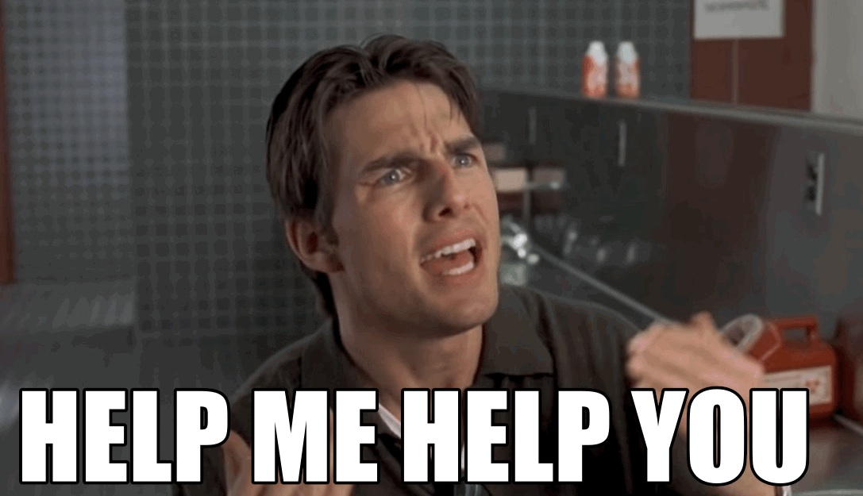
Struggling Club Support
Notes:
We created the District Membership Director role and it sort of morph into its own thing as defined by each District. More succinctly, these roles should be more focused on ensuring those Clubs who need support will get it. That is why we are initialised a name change to District Club Support Coordinator. The name itself more clearly defines what they do. We have a full-time staff person who will be a direct resource to them and the Club Support Committee is there as a research and development department. We will continue to ensure they are networked across this Country so they can share their experiences and encourage one another.

