Slide 1
District 1 Membership
FLC 2017
Stayner’s HEE HAW!

Slide 2
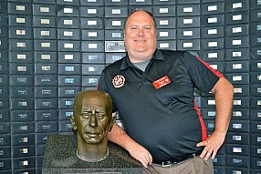
2017-2018 District Club Support Director.
Member of the Dresden Kinsmen Club since 2001
2016-2017 Cystic Fibrosis Director
Ph 519-436-1746
Email lumberjackpet@bellnet.ca

Slide 3
Wazzzuuup!
New name for the position. District membership director is now the District Club Support Director
Role : To provide support for the clubs in their district helping to create a healthy environment, club cohesion, club strength, membership development and retention, recruitment process, helping to set goals, work with the struggling clubs, provide education and resources and support the formation of new clubs, the health of all clubs and members. Assists in creating a strong membership base for the Association and continuing the growth and commitment to Kin Canada.

Slide 4
Responsibilities
  Present membership and club support workshops
  Provide assistance to clubs experiencing difficulty using the Club Health Assessment to help identify and work through situations with clubs
  Continue the relationships formed with clubs that the previous DMD/DCSD had initiated
  Promote District & National awards to further membership engagement
  Support the formation of new clubs in the zones (including Campus Clubs) and keep in contact with new clubs under 3 – 5 years

Slide 5
What kind of support?
The Club
Health Assessment
A Tool for Building Stronger Clubs

Slide 6
CLUB HEALTH ASSESSMENT - OVERVIEW
The Club Health Assessment is intended to be a club-driven tool for Kin Canada clubs. The assessment serves multiple purposes, outlined below.
Open & Honest Dialogue
First and foremost, this tool helps facilitate open and honest dialogue among all club members surrounding the performance of the club across multiple domains, all of which are an aspect of overall club health and success.
Identification of Strengths & Areas for Improvement
Through completing the assessment, clubs will have an opportunity to review and identify areas of strength for the club as well as areas where improvement may be required.
Club Planning
This assessment will help identify key areas where the club may wish to focus some of their effort for improvement in the upcoming year, and assign specific responsibilities to key individuals.

Slide 7
Club Support
This assessment may help identify specific Kin Canada resources beyond the club level (Zone, District or National) which may be of benefit to the club. This may be identified at the club level, or through discussion with the Deputy Governor regarding how to address specific club needs.
Monitor Progress
This assessment allows clubs to compare their overall club health on an annual basis, tracking areas where they may have seen improvement or a decline.
District Awareness
When shared through the Deputy Governor, it provides a detailed snapshot of club health across the District. This allows the District to be more proactive in providing club support where needed, or to identify particular resources that may benefit multiple clubs in a particular area or across the entire District.

Slide 8
CLUB HEALTH SUMMARY
1. Club Environment
The general sense of enjoyment the members are feeling in the club.
2. Club Cohesion
The decisions of the club are supported by its members and the membership is engaged in club activities.
3. Club Administration Clubs are able to conduct the business of the Club to Association Standards
4. Club Financial Health
The overall financial health of the club.
5. Club Service
The level of club involvement with respect to community service projects and fundraising.
6. Club Recruitment & Retention
Overall ability of club to recruit new members and retain current roster.
7. Club Integration
Integrated into business of the Association and actively uses resources which exist beyond the club level.

Slide 9
8. Club Strength
Overall capacity of club members to fulfill executive positions and lead projects effectively, delivering results.
9. Club Member Development
Level of club’s commitment to member development through training and mentoring.

Slide 10
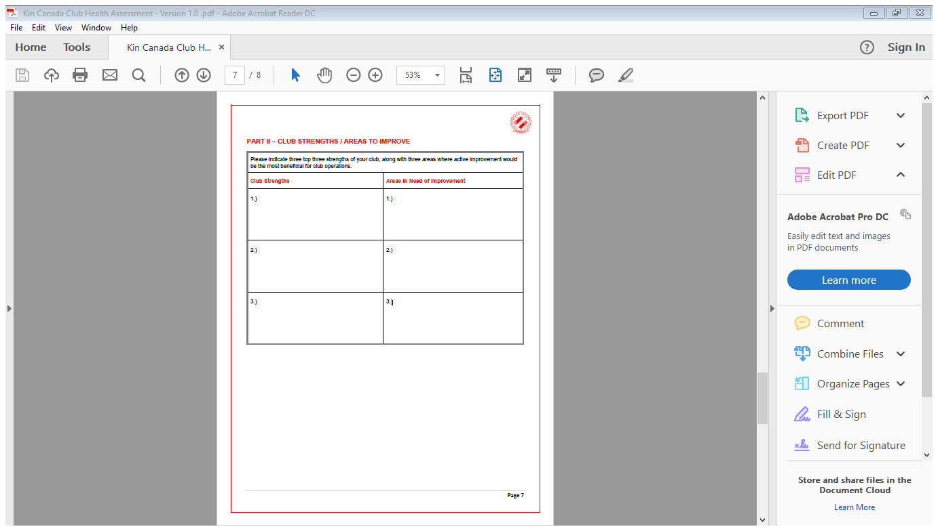

Slide 11
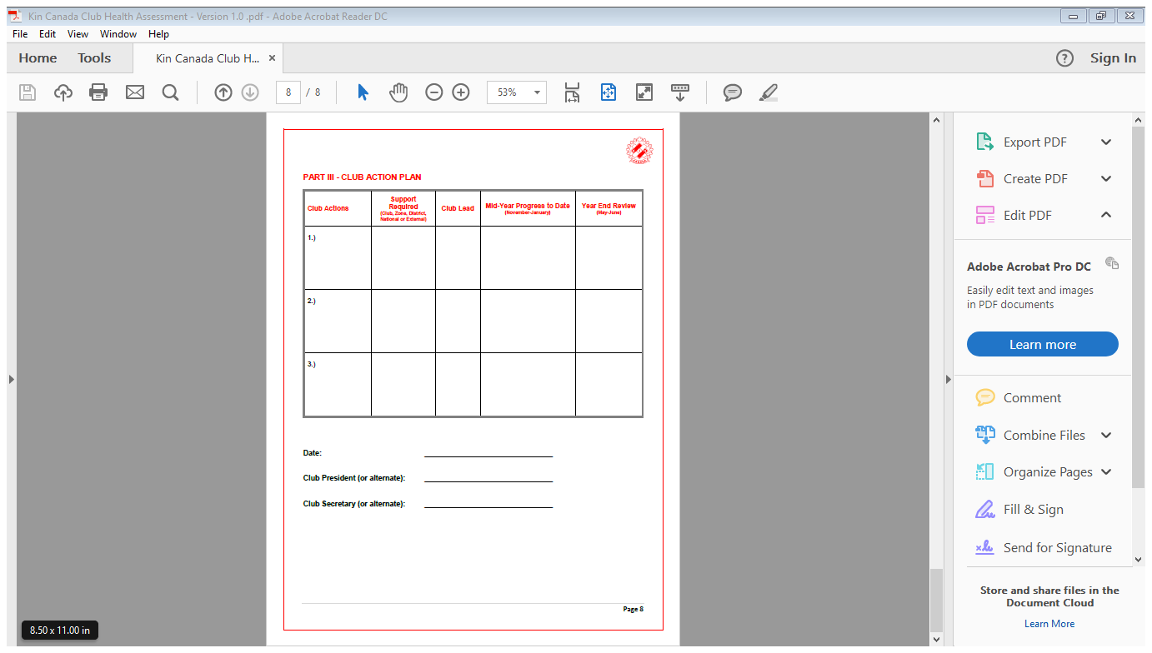

Slide 12
Mentorship Program
KIN CANADA MENTORSHIP VIDEO

Slide 13
To the Mentee:
Thank you for joining Kin Canada. We want you to maximize your membership in Kin Canada by learning about your responsibilities and building relationships within your club. This guide will help you and your mentor set goals, plan activities and track your progress as you join us on this journey of serving our communities greatest need.
Your mentor may be the Kin member who sponsored your membership or another experienced member within Kin Canada. Please work with them and have an open mind and giving spirit. If you do, you will be rewarded with a greater ability to serve your community’s greatest need.

Slide 14
To the Mentor:
Thank you for stepping up to help your fellow Kin member begin his or her journey with Kin Canada. By ensuring that our members are well versed in the customs, traditions and business of Kin, we can better serve our communities. In doing so, you are assuring that your club and Kin Canada continues to have quality members well prepared to take the lead in meeting the pressing needs of their communities.
This guide will help you and your mentee set goals, plan activities and track his or her progress as they join us on the journey of serving our communities greatest need.

Slide 15
WHAT IS MENTORING?
Mentoring is a relationship that meets a development need, benefiting all partners, mentor, mentee and the Association.
A Mentor
✓ Takes a personal interest in and helps an inexperienced member (Mentee)
✓ Serves as a coach, confidante and role model reflecting Kin Canada’s stated values
✓ Offers knowledge, insight, perspective, and wisdom useful to the Mentee
✓ Helps someone become successful and learns new skills themselves

Slide 16
With the aid of a mentor, members will:
✓ Better learn club and Kin Canada standards and customs
✓ Learn about projects, how to run a meeting, different ways of running meetings and use the KIN Rules of Order and understand the various roles of officers
✓ Develop confidence and furthers connections within Kin
✓ Learn about future opportunities that are available within Kin Canada and participate more

Slide 17
I have applications for both Mentor and Mentee’s here today. I also have a gift I would like to present all those who apply to join the program this weekend.

Slide 18
Building on the Basics – Governor Debbie and our team believe that the foundation of our association is: Fellowship, Mentoring and Personal Development. Fellowship founded the association service came about after the fact.
Through fellowship, mentoring and personal development are easier to achieve.
Fellowship makes service and volunteering fun and enjoyable.
Fellowship allows the member to grow. It exposes the member to new people, new ideas, and new concepts. All of these things help to build personal confidence in the member.

Slide 19
What is fellowship?
Notes:
Play slide show Fellowship Pics

Slide 21
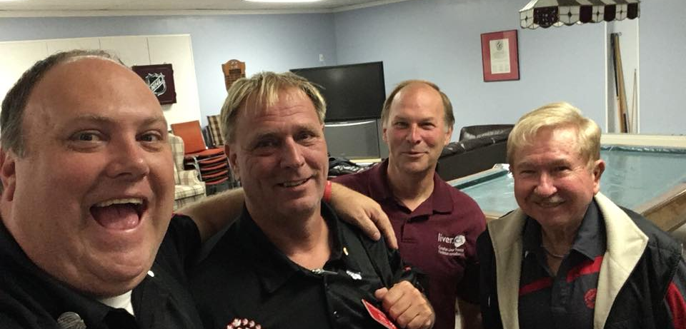

Slide 22
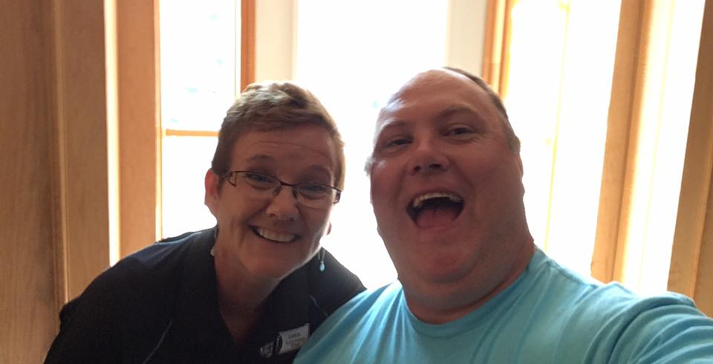

Slide 23
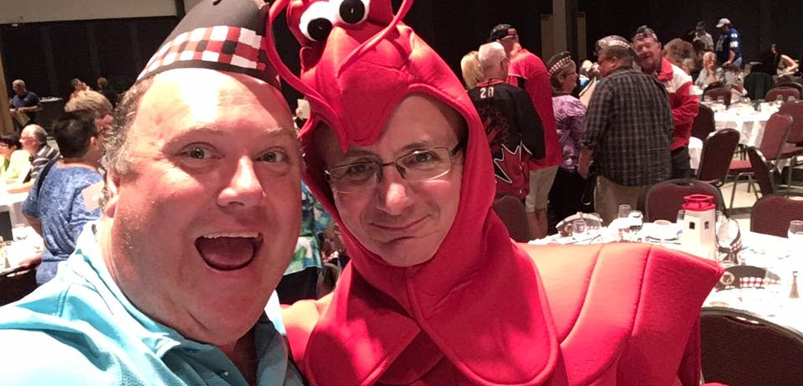

Slide 24
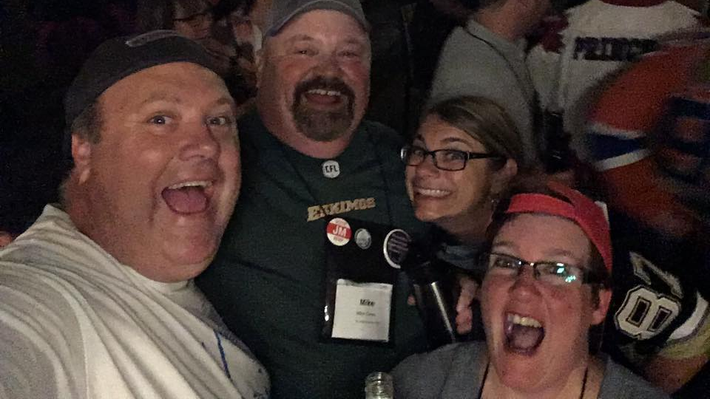

Slide 25
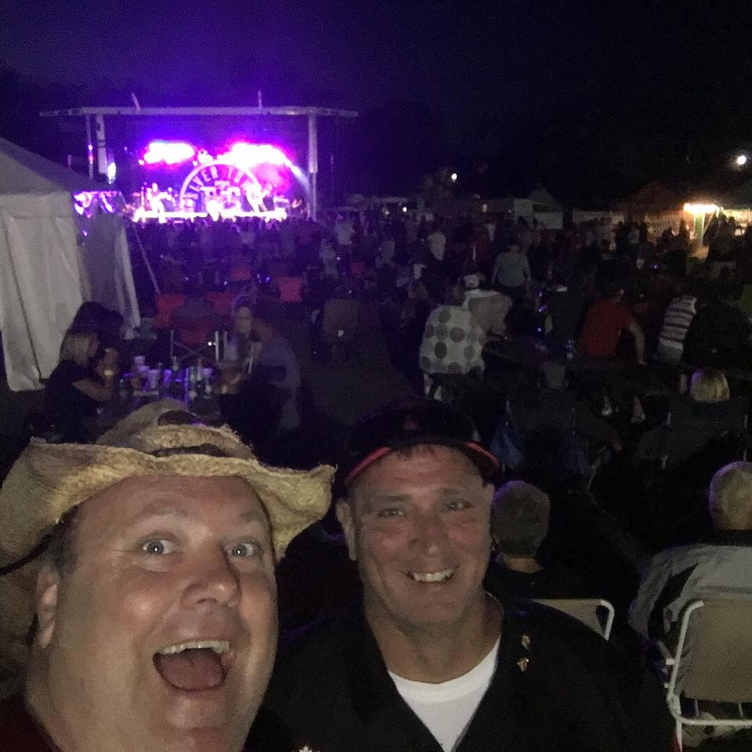

Slide 26
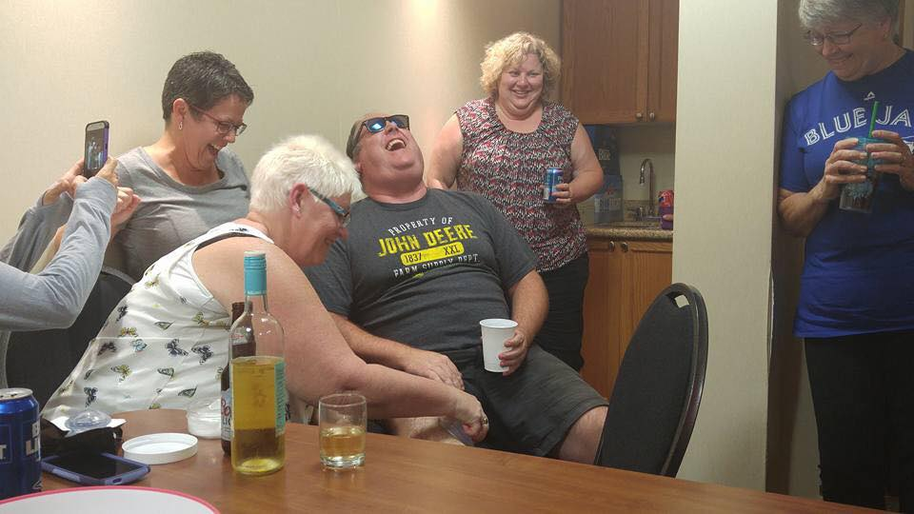

Slide 27
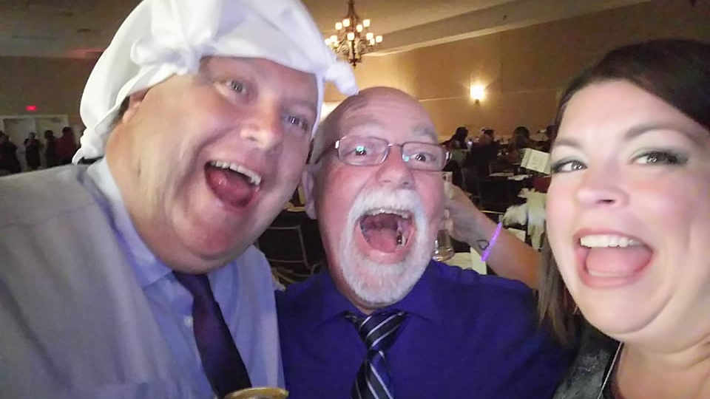

Slide 28
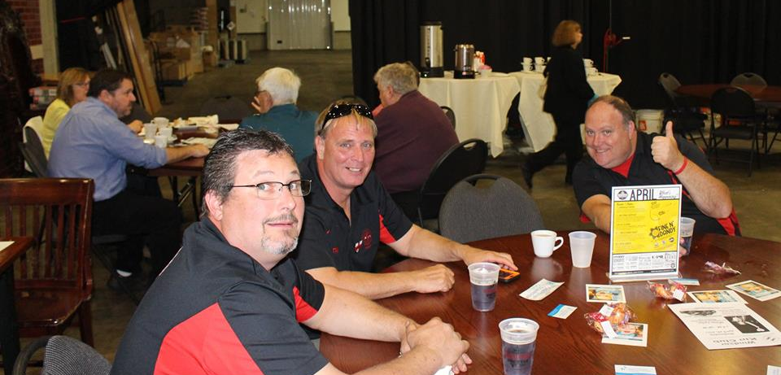

Slide 29
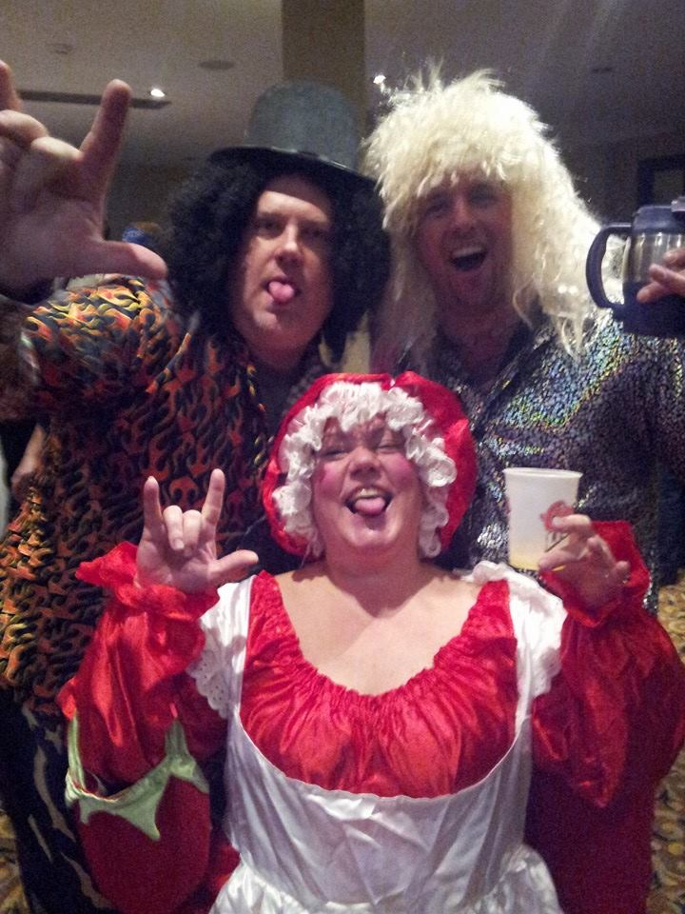

Slide 30
