Slide 1
District One
Fall Leadership Conference 2017
Service Presentation

Slide 2

Our 6th National Day of KINdness is Saturday, February 24, 2018
Look for the online form to order materials and confirm your participation in the next couple of months
Posters/media release templates/sponsorship letters available in the Member Centre
Notes:
There are many resources to help your club have a great event including kindness ideas for every budget, poster templates, media releases, and more. Even if you don’t use the resources available we want to hear about your projects and see the pictures, these can be passed on through your National Service Director or sent directly to National Headquarters. In 2017, 155 clubs participated in National Day of KINdness.

Slide 3
Service Reporting Update
Clubs are no longer required to report after each event
There will be a form sent to clubs by email in June 2018 to complete
Tools are available in the member centre so that you can track your hours and dollars
Notes:
Kin Canada’s identity is very closely linked to exemplary community service and being able to tell that story on your behalf is very important to us. Also the more hours and service dollars that are reported the more we have to leverage into new National Partnerships. The more value that we can prove Kin Canada gives the more exposure our organization received from Canadian Communities. Also we all deserve a pat on the back for our hard work and that is what happens at National Convention when we can announce the amount we donated over the year.

Slide 4
Resources Update
The National Service Project Database has been released. Check the National website to see if there is a project that your club is interested in.
More projects are also required to build the database.
Notes:
We are still looking for more projects to add to our database. Please go onto the National website and submit your clubs project.

Slide 5

Thank you District 1 for your donations in 2016-17 totaling $10,627!
9 of the 52 bursaries awarded were in District 1
Total all Districts: 70,614!

Slide 6

Thank you for your donations!
Cambridge (Preston) Kin Club
Greater London Kinsmen Club
Kitchener-Waterloo Kinsmen Club
London Kinette Club
Belgrave Kinsmen Club
Tillsonburg Kinette Club
Fergus & District Kinsmen Club
Sarnia Kinsmen Club
Lucknow & District Kinette Club
Lucknow & District Kinsmen Club
Paisley & District Kinsmen Club
Windsor Kin Club
Collingwood Kinette Club
Tara & District Kinsmen Club
Meaford Kinette Club
Walkerton Kinsmen Club
Fonthill & District Kinette Club
Fonthill & District Kinsmen Club
Clinton & District Kinette Club
Clinton & District Kinsmen Club
Goderich Kinsmen Club
St. Mary’s Kinsmen Club

Slide 7
District 1 Clubs Recognized
$2,500 Level:
Fonthill & District Kinsmen Club
London Kinette Club
Congratulations! Thank you for your contributions towards helping Canadian Students.

Slide 8
Hal Rogers Ambassador of Learning Award
Calgary Kinette Club
New award to recognize clubs promoting Kin Canada Bursaries in their community
Submissions due by June 30th

Slide 9
Increase Application Submissions to your Club
Check out kincanada.ca/service and view the Club Bursary Guide
Place copies of applications at local high schools and Community Centres
Talk to the school’s guidance counsellor to help spread the word

Slide 10

Kin Canada Bursaries:
Great for Clubs!
National recognition of commitment to education for young people
Especially relevant with Kin Campus Clubs
Bursary recipients are excellent Kin ambassadors to fellow students
Preferred bursaries (each $2,500 donation) allow for more applications from the club and increase likelihood of success.
Rejuvenation of club membership; re-investment in future
Please think of HREF when planning this year’s budget

Slide 11
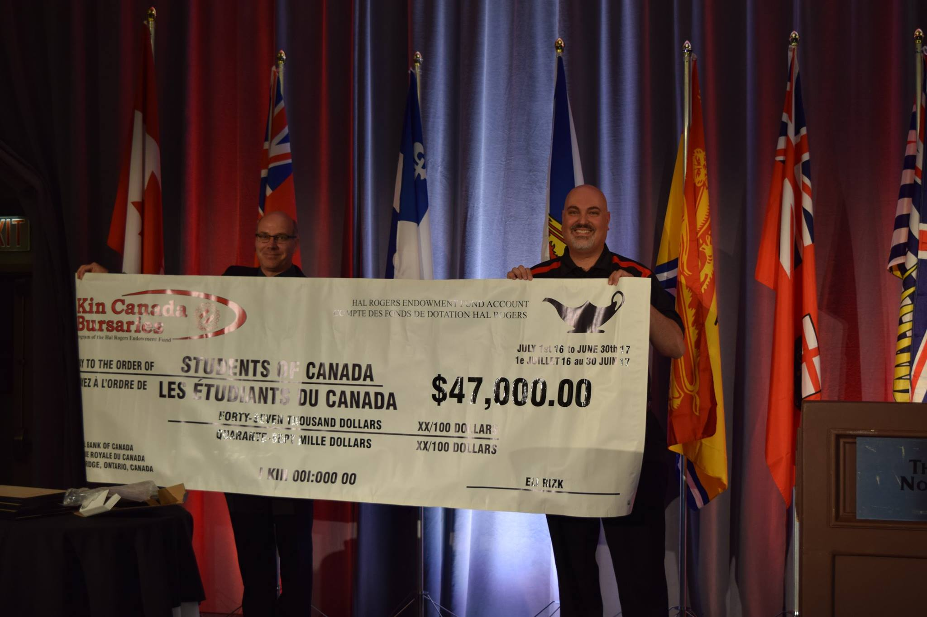
Notes:
Thank you for your donations totaling $47,000. Please remember to include Kin Canada Bursaries in your annual budget. It is very important to support the secondary education of our children and those in our community.

Slide 12

Canadian Blood
Services

Slide 13

District 1’s Blood Donation Pledge: 85 units
Units donated so far: 48 units
We have until the end of December to reach our goal.

Slide 14
National Total
Congratulations Kin Canada
You have donated 759 units of blood and we have surpassed our collective pledge of 745.
Notes:
We pledged 745 units collectively across the Districts. Just because we have hit our target we need to keep going. We have until the end of December to show Canadian Blood Services what we can do and for each District to hit it’s pledge

Slide 15
How do I Register as a Kin Member?
Use the survey to make sure you are eligible to give blood (blood.ca)
Sign up online at blood.ca using your partner for life ID (found at kincanada.ca/partnership-goals-with-cbs)
Search the permanent clinics for one near you
Book a group donation and take a road trip with your club!

Slide 16

From heart surgery that can require up to five donors to car accident victims who may need 50, donating blood is truly a gift of life. Consider joining us in our efforts to meet this vital need.

Slide 17
Questions? Can’t donate but still want to help?
Contact your District Champion, (name) at (email address)
Notes:
This year, 100,000 new blood donors will be needed to meet patient needs. That’s more than 1,900 new donors every week! Join the movement to Give Life and bring a friend! Don’t forget to use your partner ID number found at kincanada.ca/service.

Slide 18
Organ and Tissue Donation Awareness
Did you know that organ and tissue donation from 1 person can save the lives of up to 8 people and improve the lives of up to 75 people?
If you decide to become an organ and tissue donor:
Sign up via your provincial website
Discuss it with your family and friends!
To help the cause, connect with your provincial organization
(Ex. Trillium Gift of Life in Ontario) and advocate on their behalf.
For a list of provincial organizations: www.kincanada.ca/organ-donor-awareness.

Slide 19

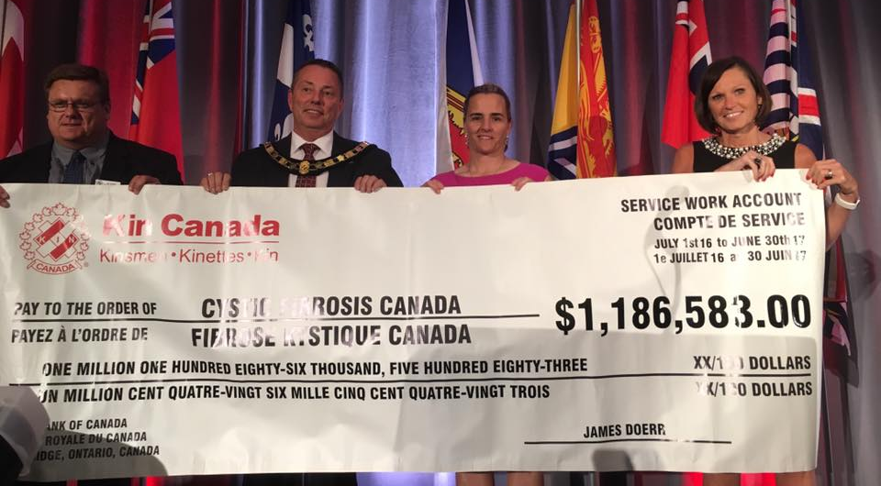
Cystic Fibrosis Canada Partnership
A 53 year partnership (since 1964)
2016/2017 CF year- District 1 raised: $370,472
This year Kin Canada raised a total of $1,186,583 and surpassed the $45 million to cystic fibrosis research and clinical care.
Thank YOU!!!!
Notes:
CF year total is Feb 1 2016 to January 31 2017 (this is what usually is reported at National as Convention happens in August which is half way into the CF year….

Slide 20
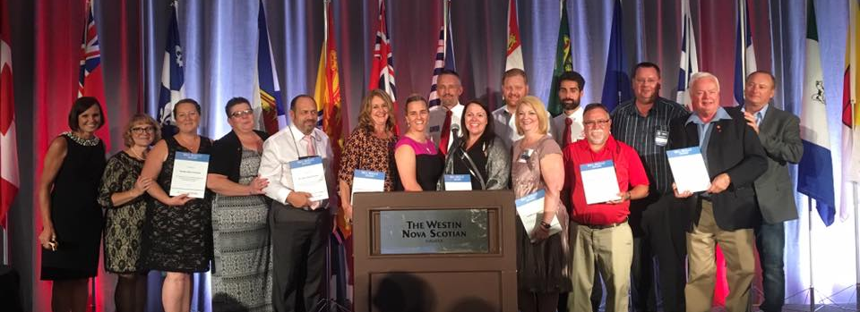
Reminders
The Bill Skelly and Ian F. McClure awards are due June 8 2018. Nomination forms can be found on: www.cysticfibrosis.ca/partners/kin-canada or contact your service director.
If you need any CF supplies/ speakers for your CF fundraising event, please contact your service director or your nearest CF Canada Chapter/ office.
Notes:
The winners for 2017 were announced the Kin National Convention in August in Halifax.
Bill Skelly Award:
The awards program is open to all Kinsmen, Kinette, and Kin clubs from across Canada. Only ONE event (not a series of events) will be considered per nomination. The event cannot be a Cystic Fibrosis Canada walk. A Bill Skelly Award will be presented to the winning club in each Kin District. In order to qualify the event must:
Take place between June 1, 2017 and May 31, 2018;
Raise funds for Cystic Fibrosis Canada (not for an individual or family); and
Raise public awareness of the cystic fibrosis cause.
Ian F. McClure Award:
The Ian F. McClure award is presented to a Kinsmen or Kinette in recognition of their exceptional skills in coordinating and motivating groups of donors and volunteers in fundraising projects for the benefit of Cystic Fibrosis Canada and Canadians living with cystic fibrosis.
There will only be ONE award given out nationally per year (not one award per district).
In order to qualify the volunteer must be a Kinsmen or Kinette who
Has volunteered their time to raise funds for Cystic Fibrosis Canada between June 1, and May 31,
Raised funds for Cystic Fibrosis Canada (not for an individual or family); and
Raised public awareness of the cystic fibrosis cause.
Next year’s nominations are due on June 8 2018 – more details and the nomination forms can be found on the Cystic Fibrosis Canada website or by asking your Service Director or Alice.

Slide 21
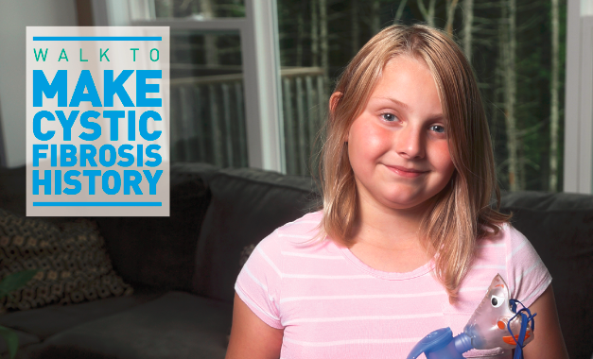
Save the Date
The Walk to Make Cystic Fibrosis History; May 27, 2018
Notes:
Kin Canada is the exclusive Volunteer Partner at Cystic Fibrosis Canada’s annual walk that raised 3.5 million in 2017.
How can YOU get involved in the 2018 walk?
Put in a team and fundraise
Help promote the walk to your community
Volunteer to help on the date of the event
Volunteer to be on the walk planning committee
Organize a walk if a walk does not exist in your area (talk to a CF Canada employee first)

Slide 22
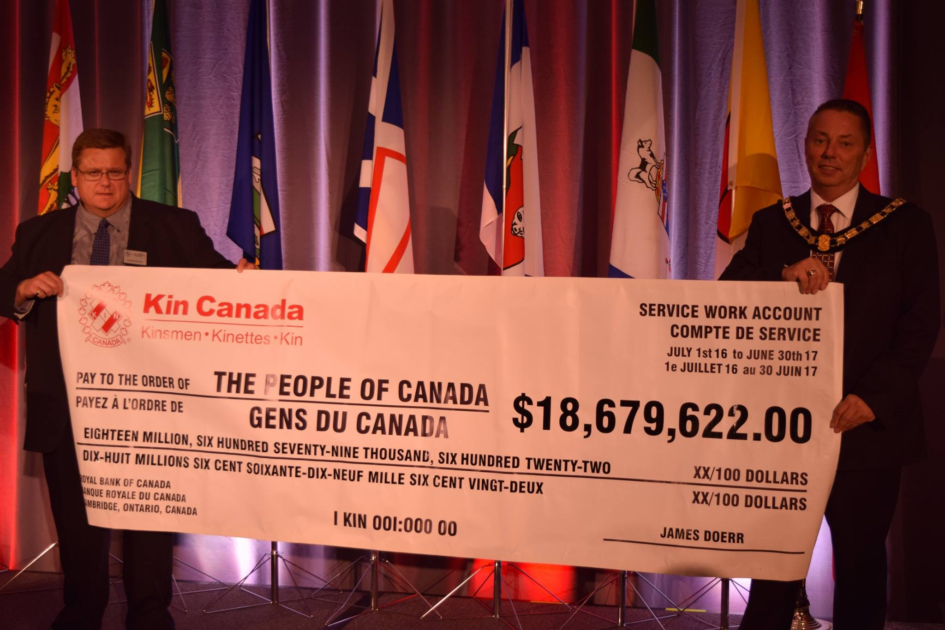
Your donation to the Canadian community this year
Notes:
$18,679,622! Proof that everything that you do can and does make a difference.

Slide 23
On behalf of the National Service Committee and Communities across Canada, Thank You for all you do.

