Slide 1
The BUSINESS OF PROPOSALS
CALLISE LOOS

Slide 2
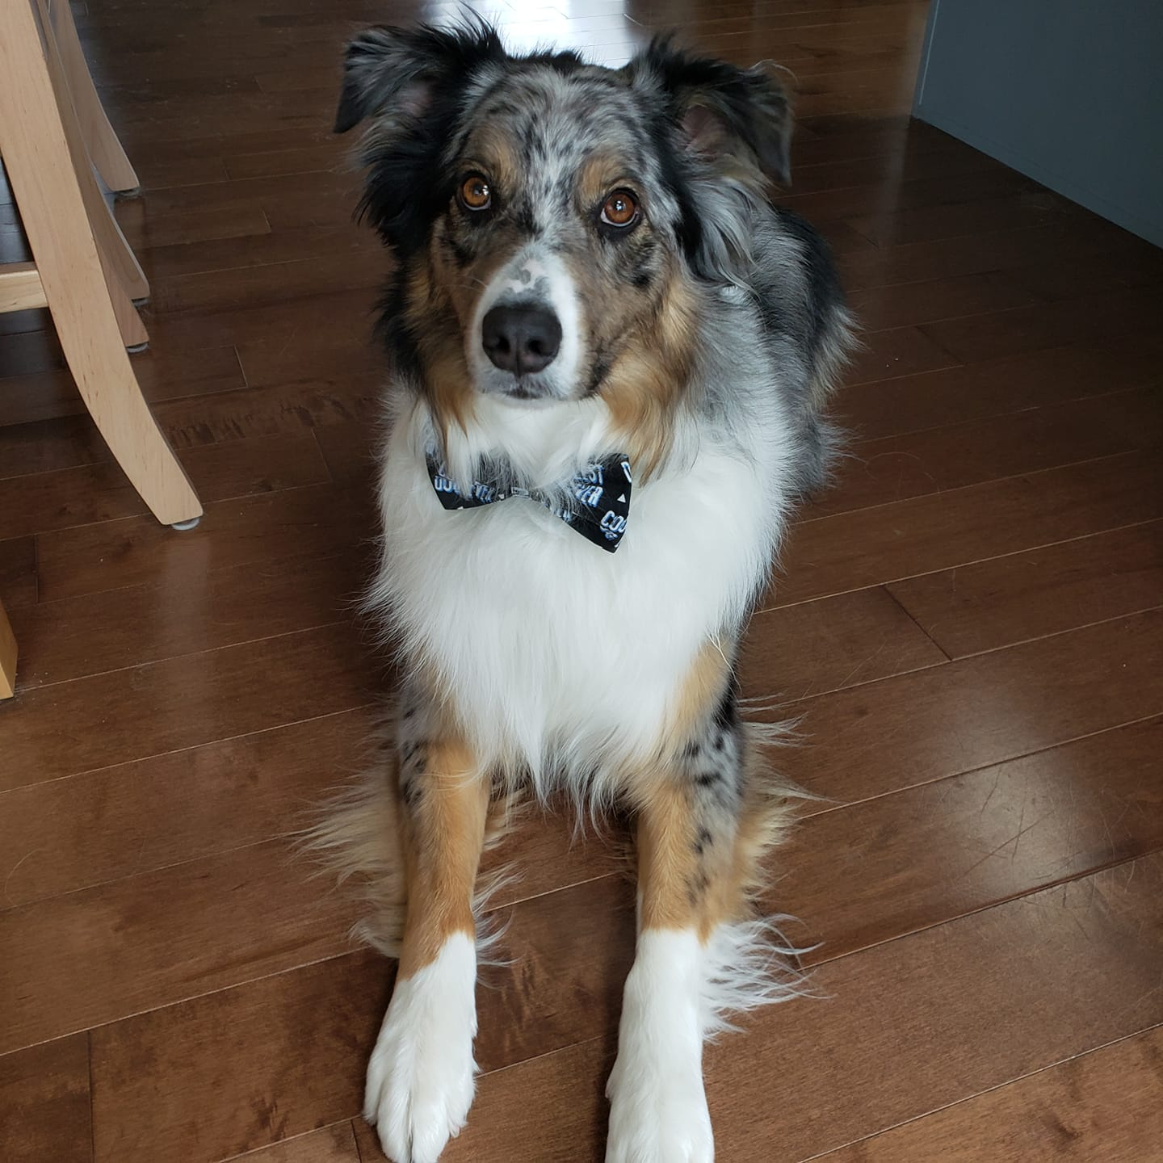
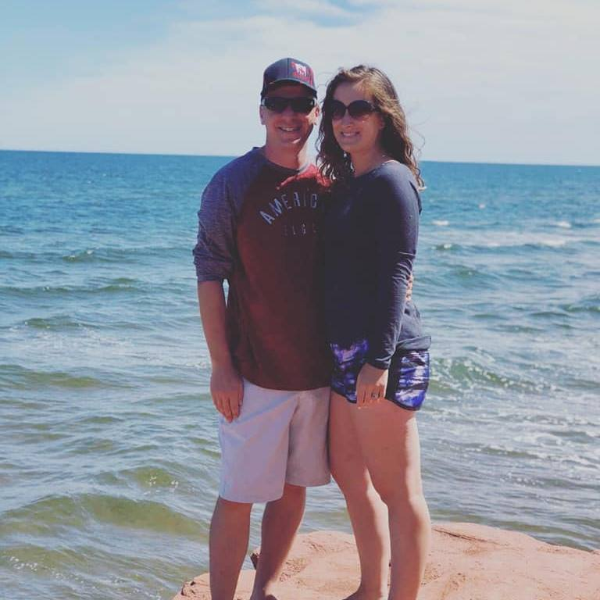
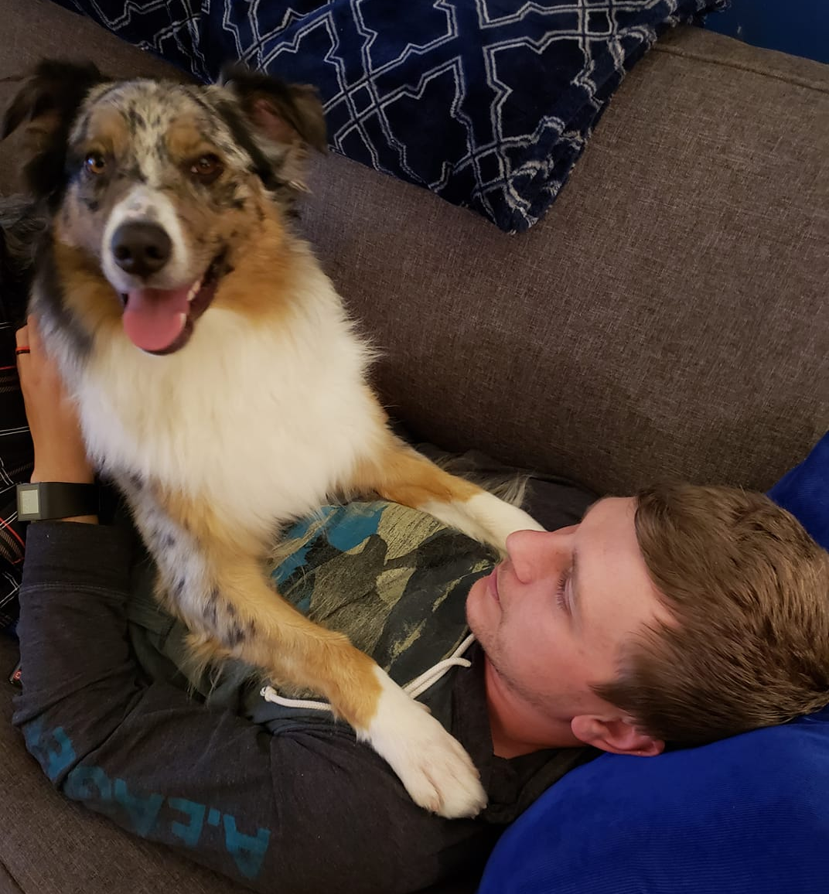
Callise Loos
Live in Harriston with husband, Mitch & aussie pup, Archie.
Education:
  BBA, Wilfrid Laurier
  Diploma in Graphic Design, NSCAD
  Certificate in Fire Service Leadership, Dalhousie University
Collector of wine, & pottery
Lover of travel & DIY projects

Slide 3
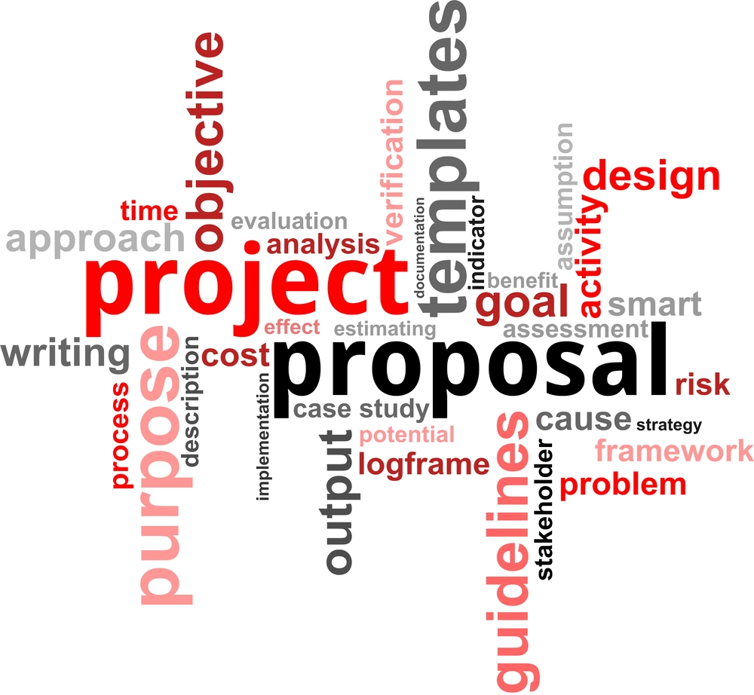
Proposal Writing for municipal council
Similar to writing a business or project plan proposal
Must include:
  A hook
  A problem
  A plan
  Your Reasoning
  Their cost

Slide 4

But first, do your market research & gather information
Failing to plan is planning to fail.

Slide 5

How to do research?
Surveys
Focus Groups
Personal Interviews
Observation
Field Trials

Slide 6
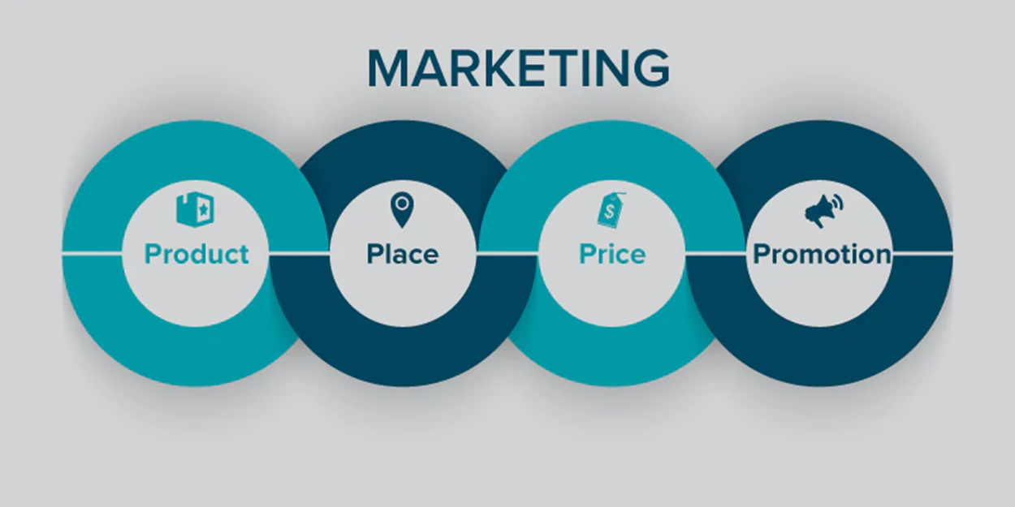
4ps of marketing

Slide 7
Product – New Initiative
Does your idea meet a specific need in the community?
  Ie: Shuffleboard Court – Need ( more activities for Seniors)
Does the idea solve a problem in the community?
  Ie: Youth Hub – Problem (Youth don’t have a space to hang out in)
Has it been completed before in another community?
Why is the idea you’re promoting the best above others?
  Ie: How many could it effect?

Slide 8
price
What is the budget for the overall project?
Will there be a cost to the municipality?
How are you going to raise funds?
Do you already have funds to contribute?
What is the perceived value of the project?

Slide 9
place
How is the project going to be implemented?
Is the idea of substantial benefit to the community?

Slide 10
Promotion – community engagement & buy in
How are you going to engage residents?
How are you going to get buy-in from the community?

Slide 11

Put the plan & presentation together

Slide 12
Proposal contents
A hook (It draws Council in)
  State a fact, state the biggest benefit of the project, propose a question…
A problem
  What is the problem in the Community you’re trying to solve?
A plan
  How is the new initiative going to be implemented including timelines, and who is responsible for the work.

Slide 13
Proposal contents
Your Reasoning
  History behind the Initiative
  Put the project in context; note any precedents and how they can help or hurt the project’s success.
  Your story
Their cost
  Projected budget, revenues & costs
  Include perceived value

Slide 14
examples
International plowing match & rural expo 2016

Slide 15
Market research 2011-2013
Does the idea solve a problem in the community?
  Area Awareness, Tourism, “Move to Minto”
Has it been completed before in another community?
  Yes, Attended IPM 2014, 2015
Why is the idea you’re promoting the best above others?
  Ie: Economic impact of the IPM is about $25 million annually
Reference: www.plowingmatch.org

Slide 16
Plan 2014 - 2016
Implementation Period (3 years)
Budget: 3 million
Cost to Municipality:
  Municipal Tourism Booth
  Costs of Beautification & Staff Time
  Costs of increased Emergency Services
Reference: www.plowingmatch.org

Slide 17
Wellington plowmen’s reasoning
Wellington hadn’t had the IPM in 20+ years
All the money donated back to Charity
Legacy Piece
Reference: www.plowingmatch.org

Slide 18
Getting support & engagement from community

Slide 19
Strong brand & visibility in the COMMUNITY
Building a positive organization brand is key to community support
Ensure your brand is visible:
  Social media, website
  Advertising
  Community Assets
  Be responsive

Slide 20

Create ownership in the community
Consult with the community
  BEFORE YOU START
Ask them to get involved
Keep them informed
Celebrate successes

Slide 21

AWARENESS
TRUST
EDUCATION

Slide 22
examples
International plowing match & rural expo 2016

Slide 23
Community engagement
Logo Selection Contest
Volunteerism
Community Decorating Contests
Community Events leading up to IPM
Regular Updates to Council, Regular updates to Community
Accountability & Transparency are key
Open to change

Slide 24

Thank - you
Time for questions…

