Slide 1

Using social and print media to engage your community
D1 Club Leadership Seminar
September 2019

Slide 2
Agenda
Why having an online presence is essential
How to use social media effectively to connect with your community
How to use print media to increase awareness about your club
The power of social media

Slide 3
Exercise
How far will my post on Kin Canada’s public Facebook page reach by the end of this presentation?
Go to Kin Canada’s public Facebook page and take a minute to share the announcement.

Slide 4
Why an online presence is essential
How many people do you think are on Facebook, Twitter, YouTube, and Instagram at this very moment?
Liveinternetstats.com

Slide 5
Why use social media
Social media and the internet is how people find their news and information
People are in front of screens most of the day; make use of this direct access to them
It’s a FREE marketing tool that requires minimal investment

Slide 6
Using social media effectively
Tell a story
Share your impact
Highlight your members/club fellowship
Make use of existing tools
Build hype for your events
Create engaging content
Interact with others
Thank your donors and community
Spread the word

Slide 7
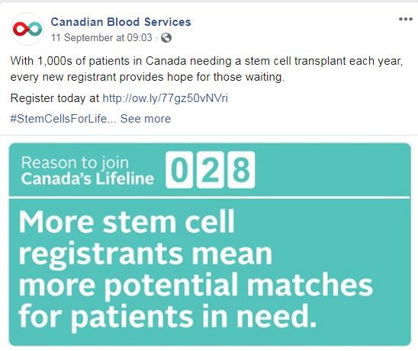
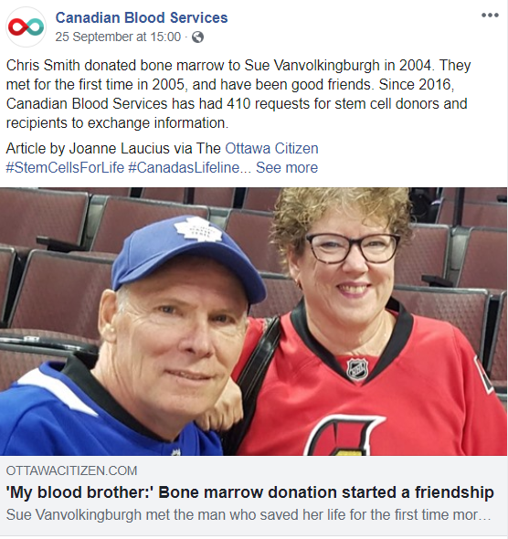
Tell a story
Which one is more effective?

Slide 8
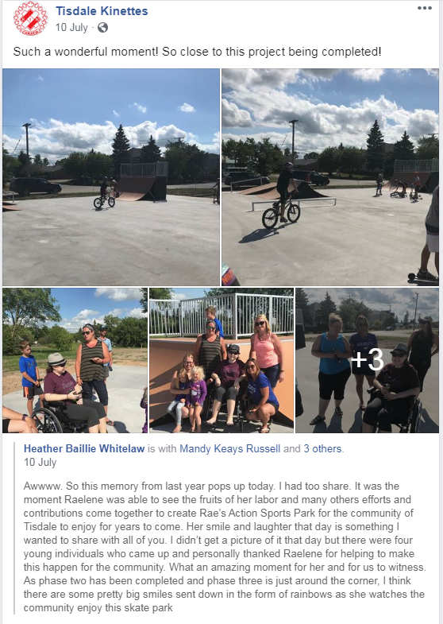
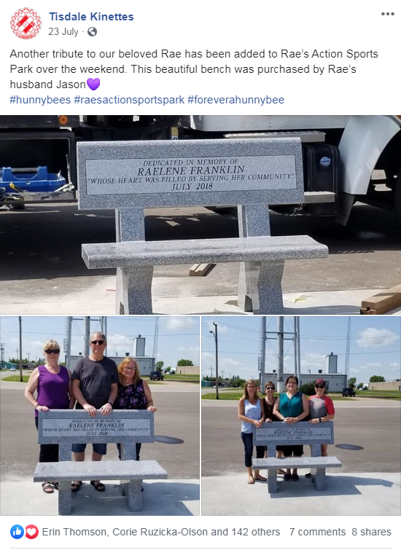

Slide 9
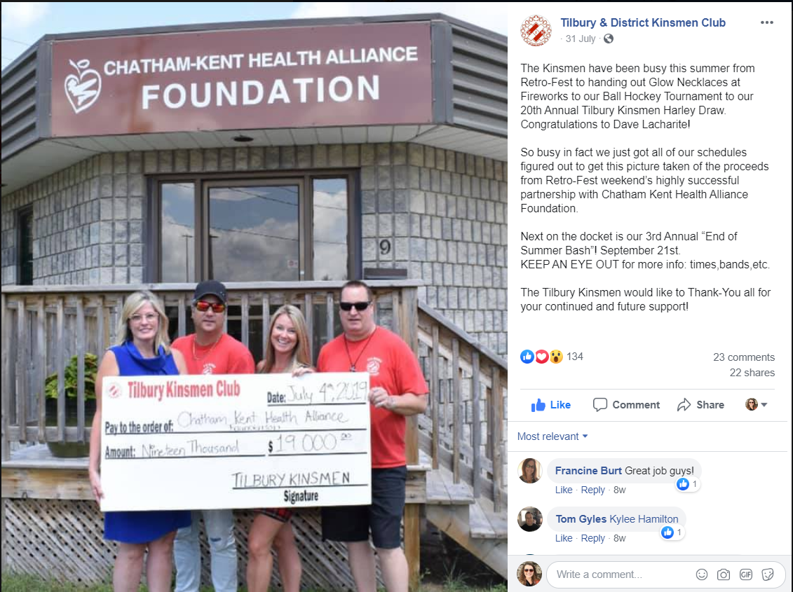
Share your impact

Slide 10
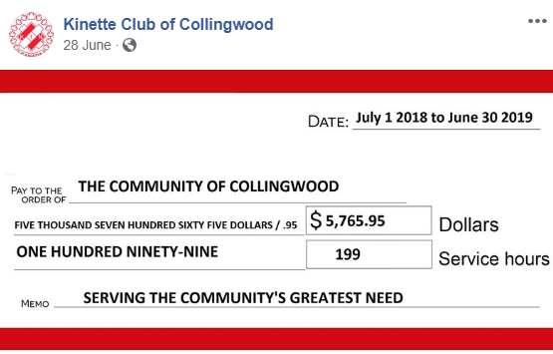
*This resource is available on iKin under Service – Service Resources

Slide 11
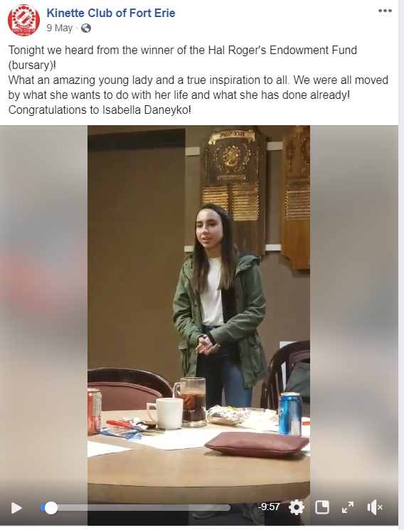
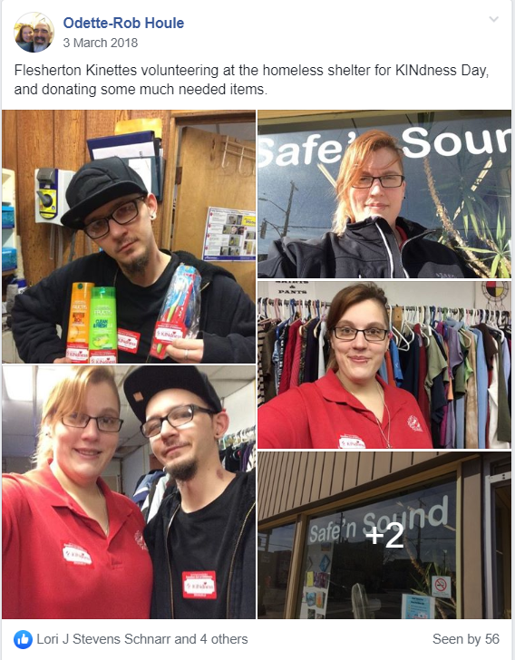

Slide 12
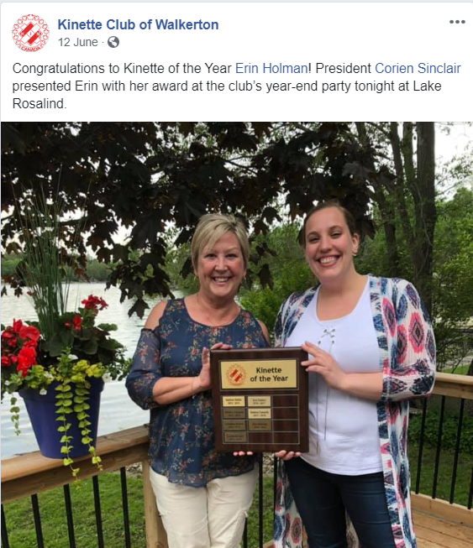
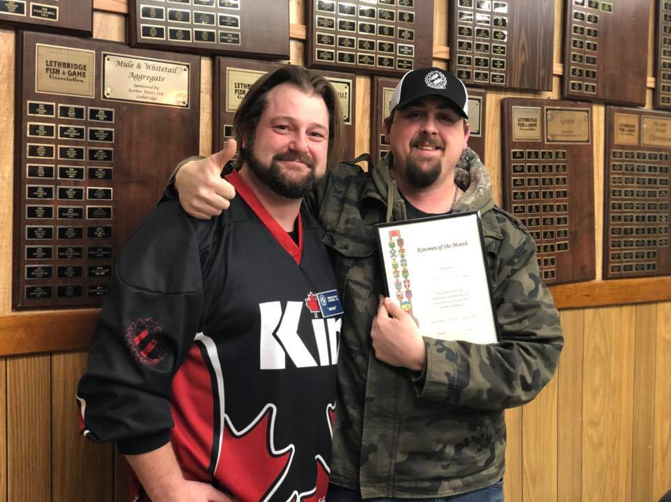
Highlight your members
Your fellow Kin have other friends, family, colleagues, and neighbours. Brag about your members and make it easy for them to share their accomplishments with others!

Slide 13
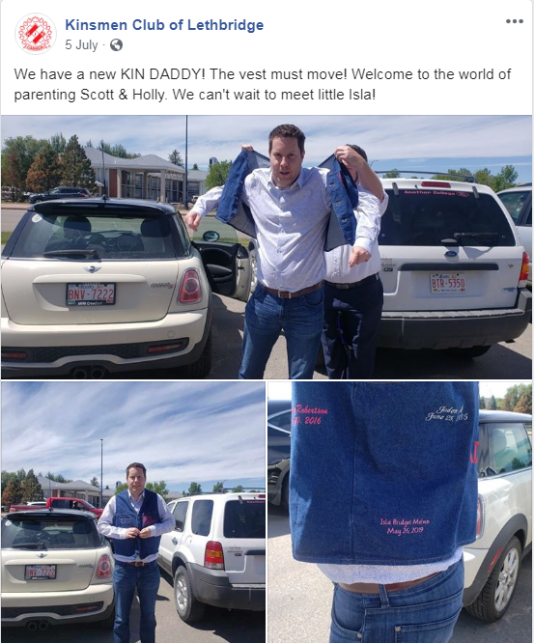
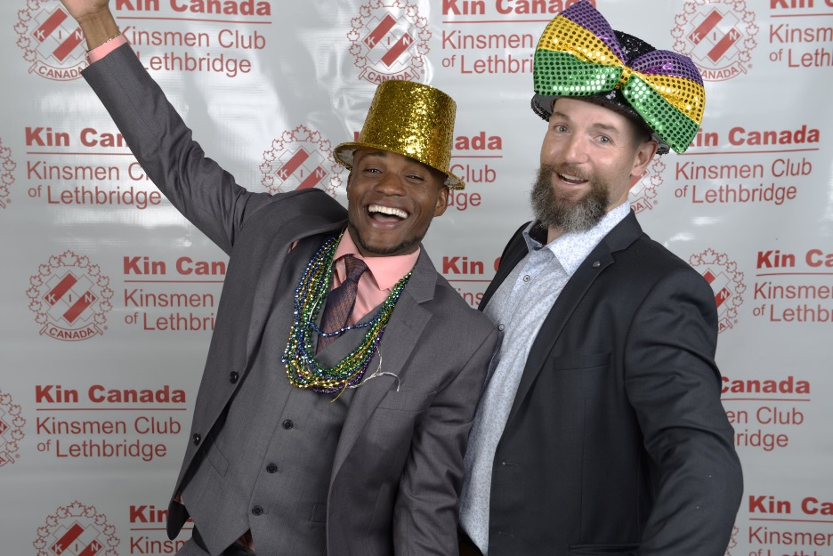
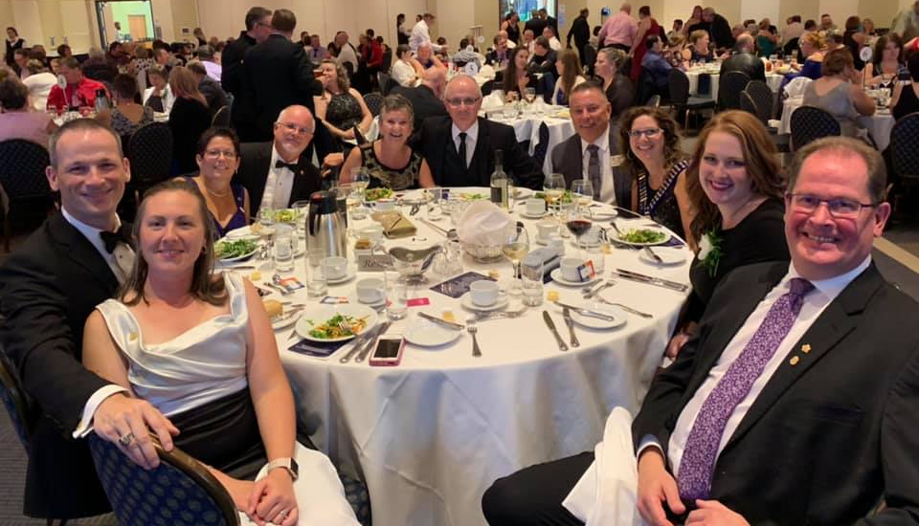
Show your fellowship

Slide 14

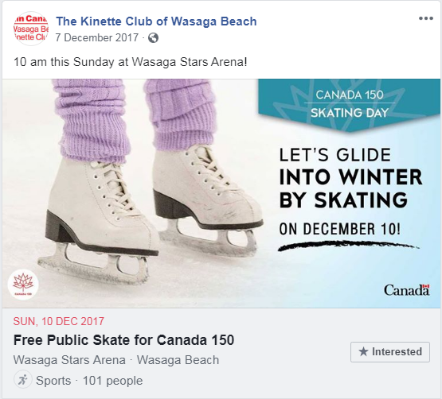
Use existing tools

Slide 15

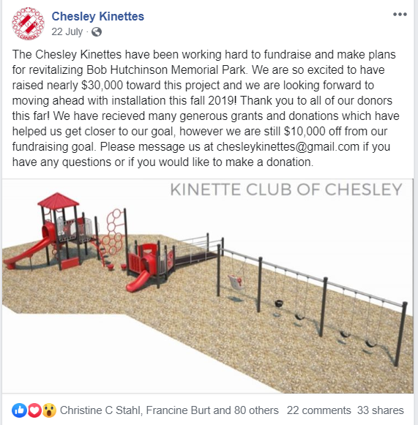
Build hype

Slide 16
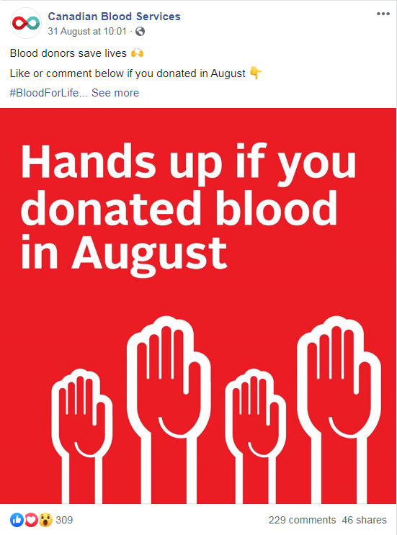
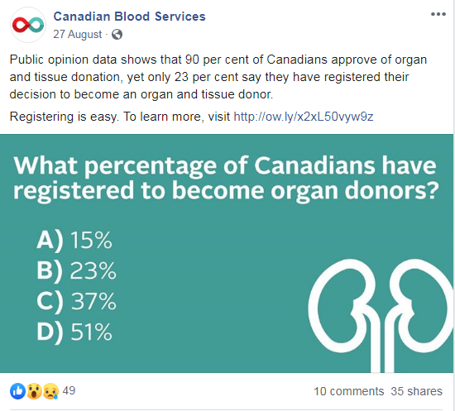
Create engaging posts
Get people talking!

Slide 17
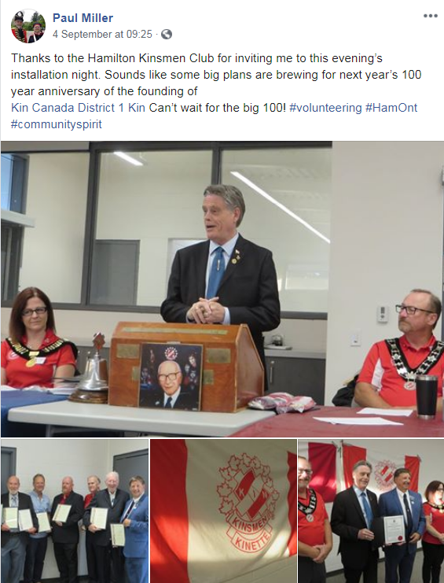
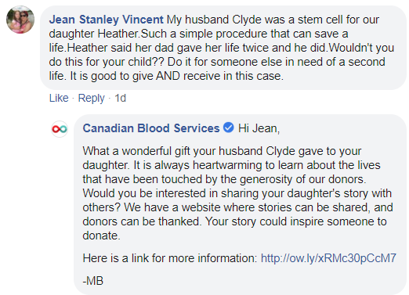
Interact with others
Social media is all about connecting and engaging.

Slide 18
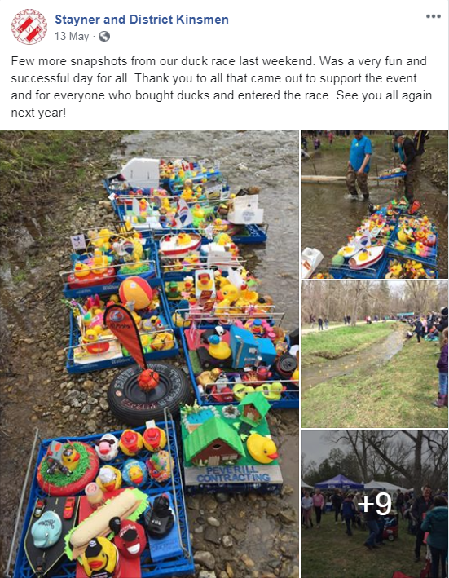
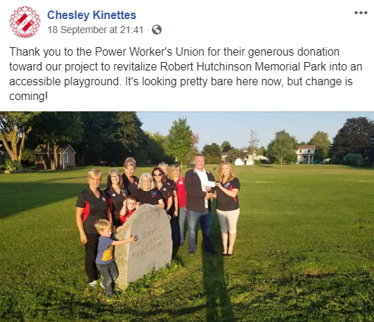
Thank your donors
Don’t forget to thank your event attendees and your volunteers too!

Slide 19

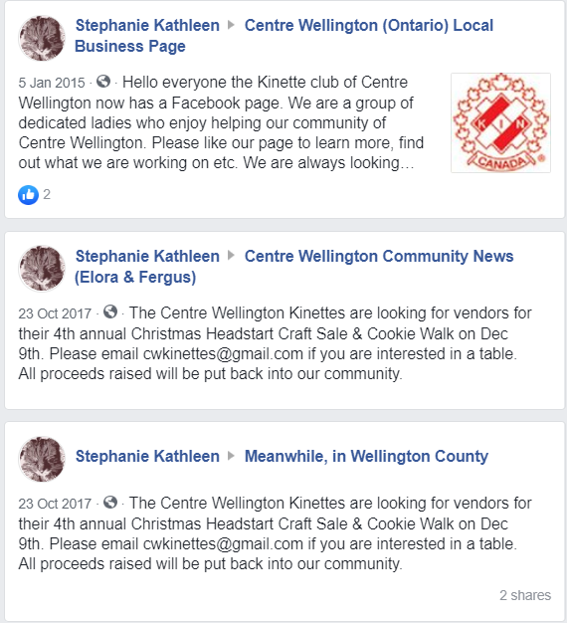
Spread the word

Slide 20
Engaging your community through print media
Send news releases often
Develop relationships with local media
Put a call out for volunteers
Invite the community to attend a meeting
Invite your municipal leaders out to your events or to speak at a meeting
Identify other local influencers
Be visible – hand out print materials

Slide 21
Engagement Resources
Municipal Engagement Guide
iKin - Club Support – Engagement Resources
News release template
iKin - Service – Service Resources
Newspaper Ad Template
iKin - Marketing – Marketing Resources
Marketing Materials Request Form
iKin – under Marketing – MMR Form

Slide 22
How many people did we reach?

Slide 23
Krista Nicol
Communications Coordinator
knicol@kincanada.ca
800-742-5546 x204

