Slide 1
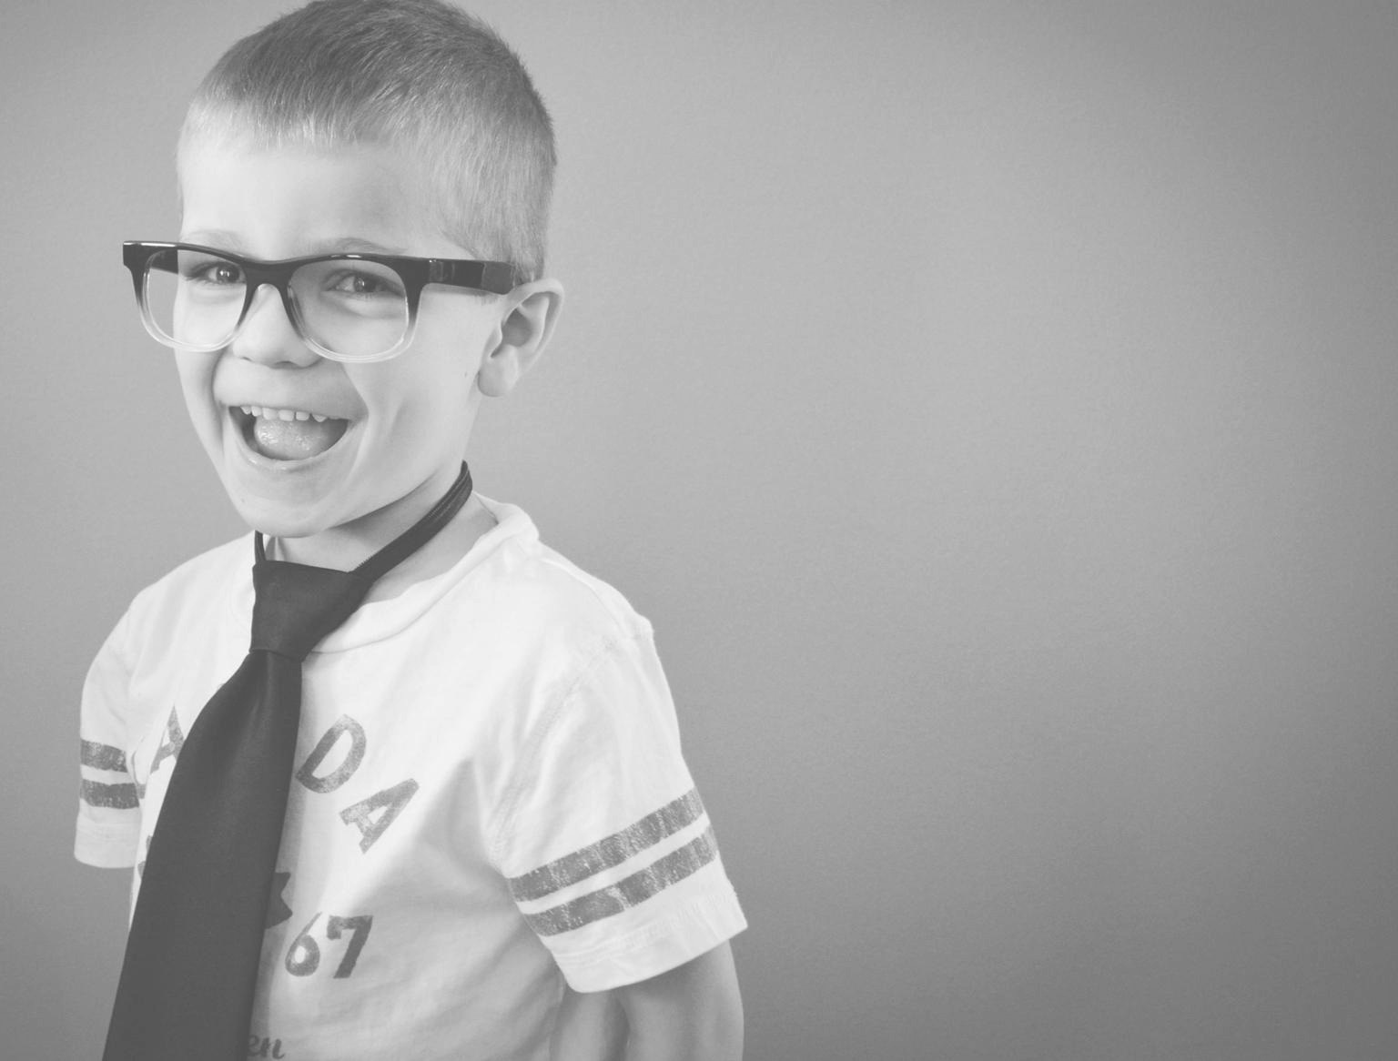

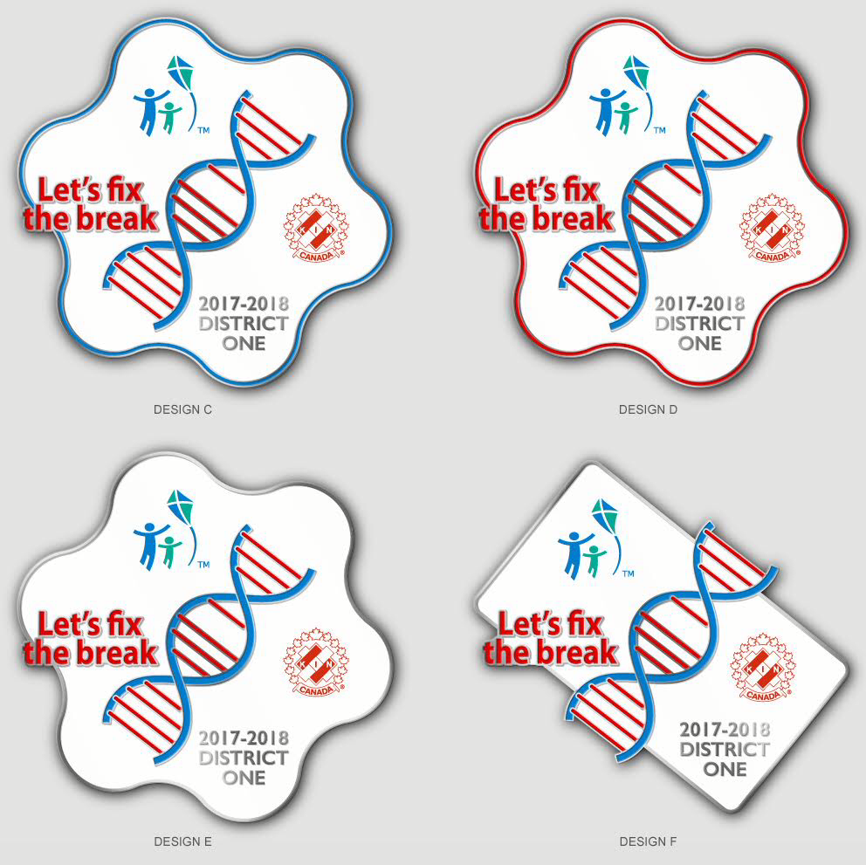
DISTRICT ONE
CYSTIC FIBROSIS &
SERVICE
CLUB LEADERSHIP SEMINAR 2017-2018

Slide 2
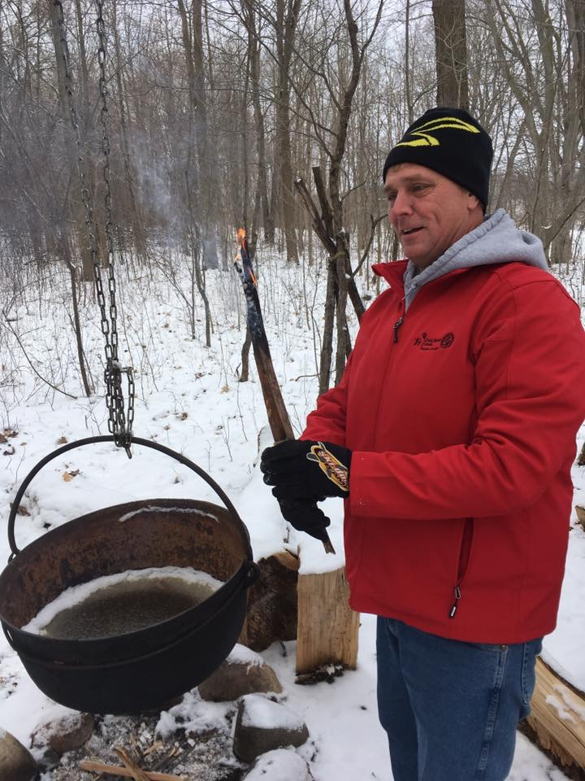
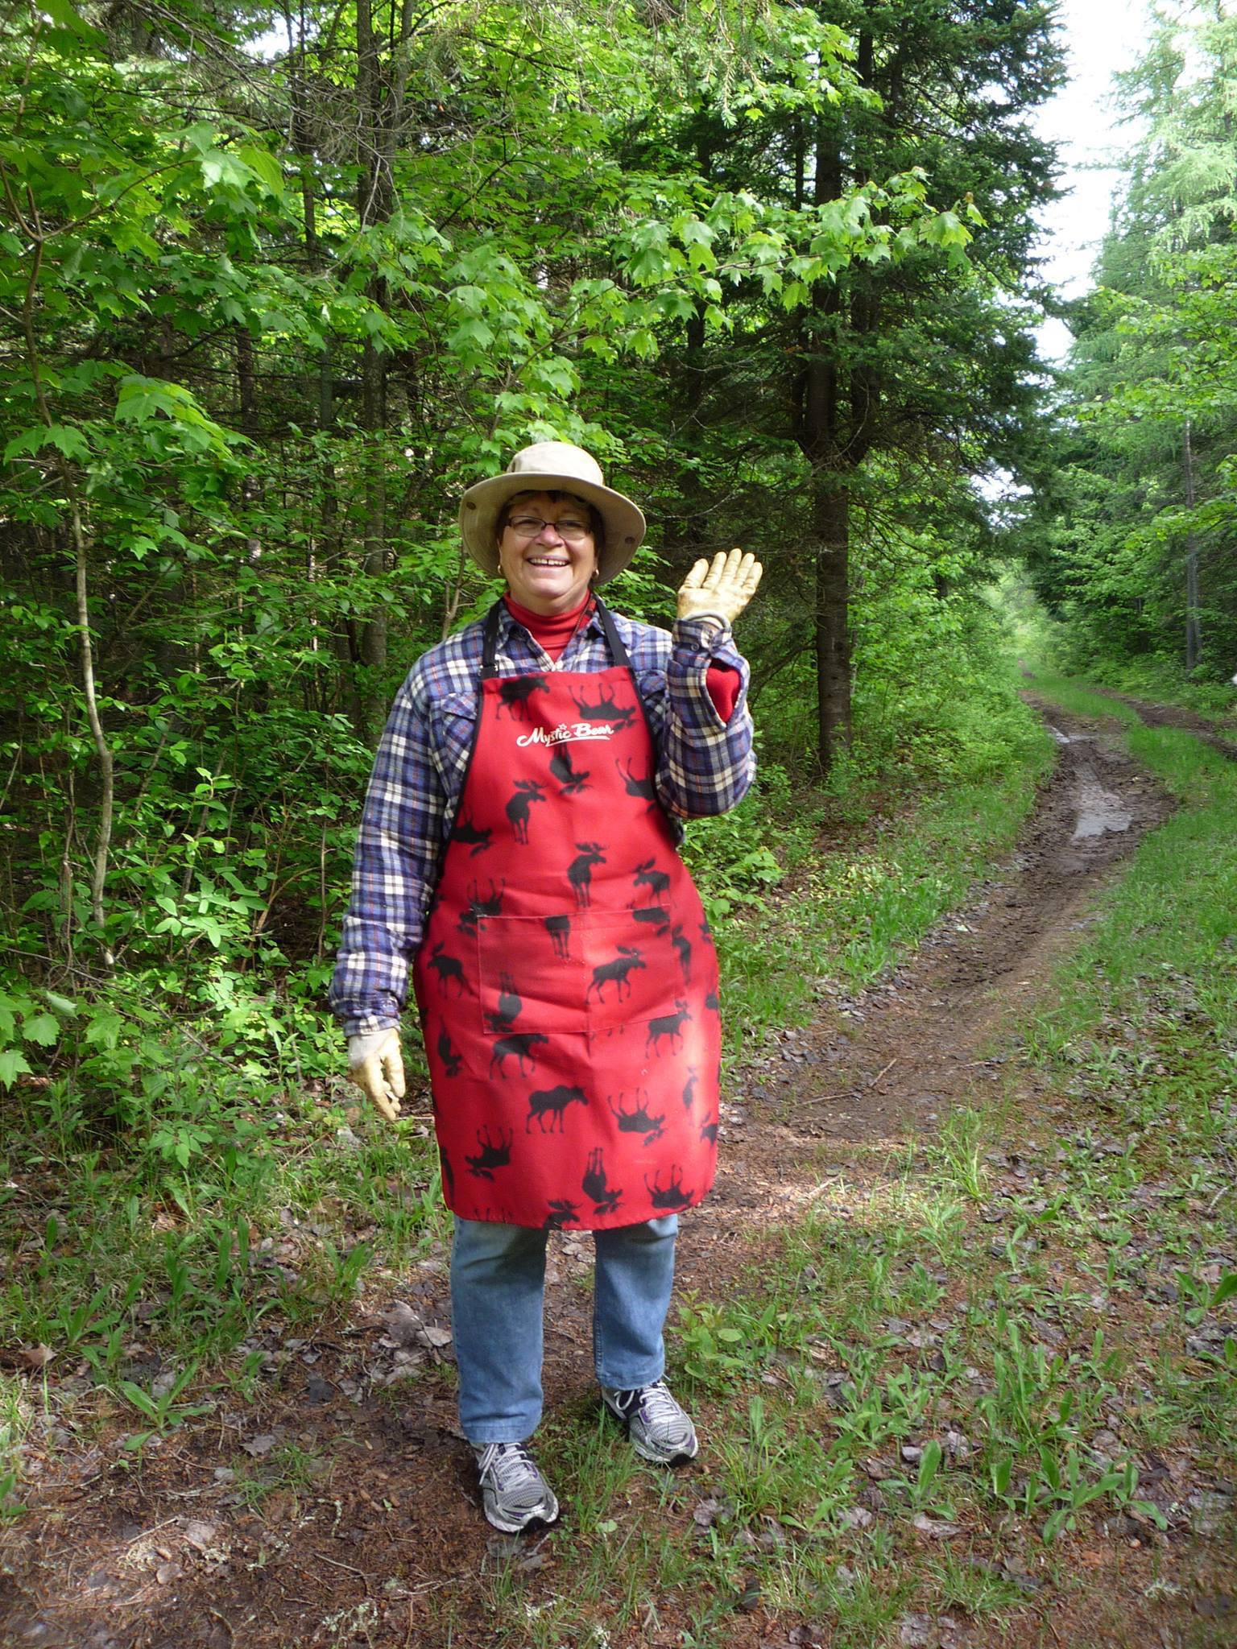
CYSTIC FIBROSIS/SERVICE DIRECTORS
Tim Natyshak & Bea Crowley

Slide 3
CYSTIC FIBROSIS/SERVICE DIRECTORS
Tim Natyshak & Bea Crowley
Tim
Member of Tilbury Kinsmen since 2009.
Hobbies include: Hunting, Fishing, Yardwork.
Goal for this year: increase awareness through zone CF information nights, improve on NDoK, and improve on HREF.
I am looking forward to the challenge of being District 1 CF/ Service Director.
Bea
Bea
Member of the London Kinettes.
My hobbies are: I like to cook, can, knit, crochet, toll paint.
Grammy to 5 wonderful Granddaughters and mother to five wonderful children.
My goals are Tim’s goals. Together we hope to make you all shine.

Slide 4
DISTRICT ONE
THEME FOR THE YEAR...
Our theme this year is…
Pins are $7.50
Bags are being made up for each DG - you are responsible to keep track of these and hand in money. Sell, sell, sell!

Slide 5
CYSTIC FIBROSIS/SERVICE DIRECTORS
Tim Natyshak & Bea Crowley
What can we do as Cystic Fibrosis Service Directors?
- Help you make contact with Chapters
- Find guest speakers / be a speaker at events
- Man power at events
- Project Ideas
- Communication
- Swag & Supplies (i.e. balloons, pens, brochures, coin boxes,
posters etc. – please note we need 4 week lead time)
- Support! Whatever you need, let us know!

Slide 6
CYSTIC FIBROSIS / SERVICE
DG’S / ZONE REPS
What can you do as Deputy Governors?
- Put us in touch with your zone CF Service Rep (if you have one)
- Encourage clubs to donate to Cystic Fibrosis and the Hal Rogers Endowment Fund
- Support other Kin initiatives (noted in remainder of slideshow)
- Ask us for information for newsletters / bulletins
- Invite us out to anything and everything! We can speak at events, help with man power, whatever you need!
- Keep us informed on what is happening in your zone

Slide 7
DISTRICT ONE
SERVICE REPORTING
During the 2016-17 year 29 clubs reported their service hours for District one by the deadline. After numerous emails and messages we managed to get just above 40% We need to drastically improve this number for the coming year.
The reporting has gone back to just once a year and the deadline is June 15. It is online and it only asks for total service dollars and total service hours for the whole year.
Note that we will get you a current list of clubs in your zone who did not report this year so you can make sure you cover the process with them In your visits. do not call them out on it, just reinforce the district performance and the need to improve as a district going forward.
Goal for the 2017-18 year is to have have district one increase our reporting percentage to 60%

Slide 8
DISTRICT ONE
NATIONAL DAY OF KINDNESS
In 2017, District One had 34 clubs actively
participating in this event.
SAVE THE DATE! Fifth annual National Day of KINdness will be on February ?, 2018.
We can provide you with ideas for events for all budgets and also direct you to get some awesome swag to use!
Goal for 2018 is to have 50 clubs participate in
National Day of KINdness – that’s just over 1 club
per zone!

Slide 9
DISTRICT ONE
HAL ROGERS ENDOWMENT FUND / KIN CANADA BURSARIES
Year to date District One has donated $8,927.00
This year 23 applications were submitted, with 9 being successful in district 1.
By donating to this cause, we can help students fulfill their dreams of pursuing post-secondary education.
During your first visits to clubs, remind them of the Hal Rogers Endowment Fund / Kin Canada Bursaries and mention the idea of putting a line item in their budget to donate to this cause… together we can continue helping students.

Slide 10
DISTRICT ONE
DISASTER RELIEF FUND
The Disaster Relief Fund provides short-term immediate financial assistance to both national and international areas declared a disaster area.
If you want your donation to be put to a specific cause, indicate the name of the disaster on the memo line of your cheque (i.e. District 4 – Alberta Fires).
In the past, the Disaster Relief Fund has helped with Tornado Relief in Goderich, Fires in Slave Lake, Earthquake Relief in Haiti, Tsunami Relief in Southeast Asia, Hay West Project, and Beef for BC.
Most recently, District One donated $500 from our fine pot at
Spring Convention to the Alberta Fires.

Slide 11
DISTRICT ONE
ORGAN DONATION AWARENESS
Did you know that organ and tissue donation from one person can save the lives of up to eight people and improve the lives of up to 75 people? If you decide to become an organ and tissue donor, sign up via your provincial website AND discuss it with your family and friends. Loved ones are always asked before donation happens, so it's important that they know you would like to donate. Make your wishes known!
Visit kincanada.ca/canadian-blood-services

Slide 12
DISTRICT ONE
CANADIAN BLOOD SERVICES
This years pledge across Canada is 680 units of blood –of which 80 are slotted for District One. We are currently at 27 unit .
District One Kin ID is KINC110223
You can sign up online and all of your donations will automatically go towards our goal… share this with all of your friends and family!
Nationally in 2017 we have surpassed 400 unit of blood
Why not make it a fun night out and donate blood as a group? Lets surpass our goal this year!

Slide 13
DISTRICT ONE
KIN CANADA FOUNDATION, 49TH PARALLEL NORTH FUND
The objective of the Fund is to honour and show respect to fallen Canadian First Responders (Military, Police, Firefighters and EMS) by raising the necessary funds to award a Hal Rogers Fellow to their families.
The Fund is designated to cover costs for the award and the required regalia associated with presenting the HRF award.
The Fund also provides financial assistance for post-secondary education or training for family members of the fallen.
Check out www.kincanadafoundation.ca for more information.

Slide 14
DISTRICT ONE
CYSTIC FIBROSIS
Once again, due to Kin Canada’s remarkable dedication and passion to end CF, Kin raised 1,186,583 $ in 2016/2017 that will go towards CF research, healthcare and advocacy.
If clubs are organizing an event in support of Cystic Fibrosis Canada and need a CF speaker, information about CF, or fundraising ideas for your event, please let us know and we can help you find those resources!

Slide 15
DISTRICT ONE
CYSTIC FIBROSIS
This year our goal across Canada is to raise 1.2 million dollars for Cystic Fibrosis. Although we don’t know our goal here in District One, we can only guess it will be around $380,000… let’s start working on meeting and beating this goal!

Slide 16


Slide 17
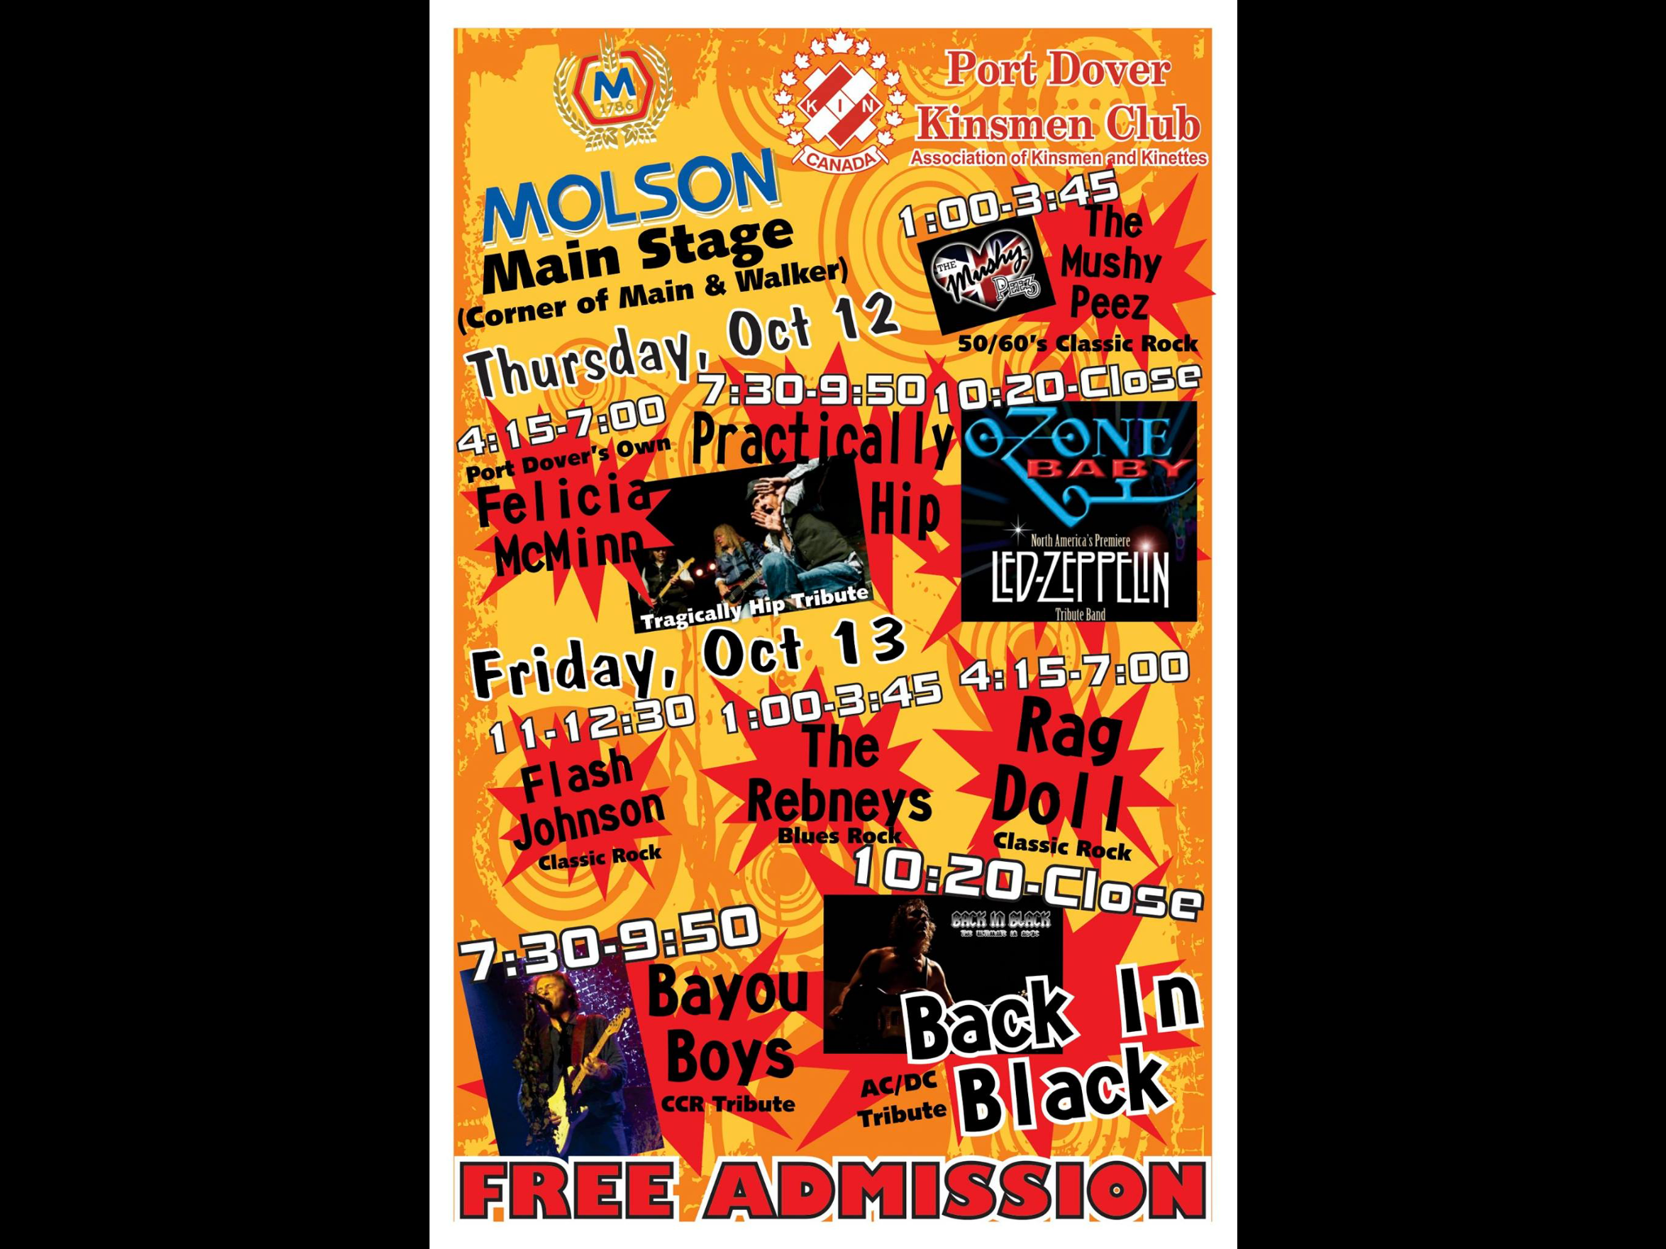

Slide 18
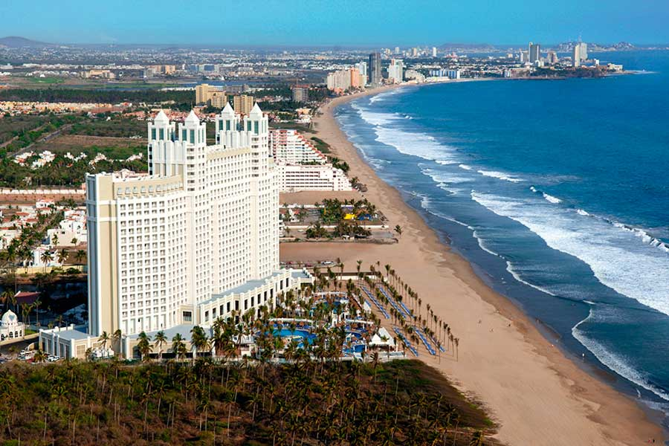
DISTRICT ONE
ANNUAL CYSTIC FIBROSIS TRIP
This year we will be going to Riu Emerald Bay in Mazatlan, Mexico!

Slide 19
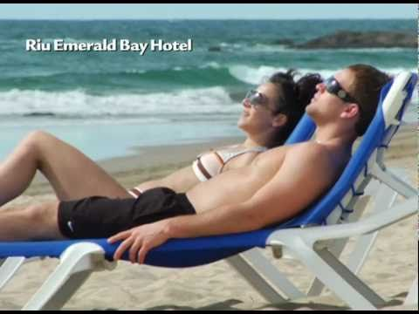
DISTRICT ONE
ANNUAL CYSTIC FIBROSIS TRIP

Slide 20
The trip will be early April 2018 with pricing coming in
Under the 1500$ per person price point!
See you on the beach!!!
Don’t forget about your 50$ donation to CF!
SOLD OUT

Slide 21
DISTRICT ONE
HOW TO FIND US…
Tim
Cell (text or call): 519-436-9520
Email: tnatyshak@gmail.com
Bea
Cell (text or call): 519-282-7415
Email: dcrowley@quadro.net
Please make sure to let us know if you need help with anything (i.e. speakers, promo material, assistance at events). We are here to help YOU and YOUR CLUBS, so please use us!

Slide 22
THANK YOU
Thank you for everything you do, and everything
you continue to do for your communities and to
help find a cure for Cystic Fibrosis.

